Slide 1

Intro to Solid Mechanics: SolidWorks FEA Final Project
By: Franz von Dyck

Slide 2
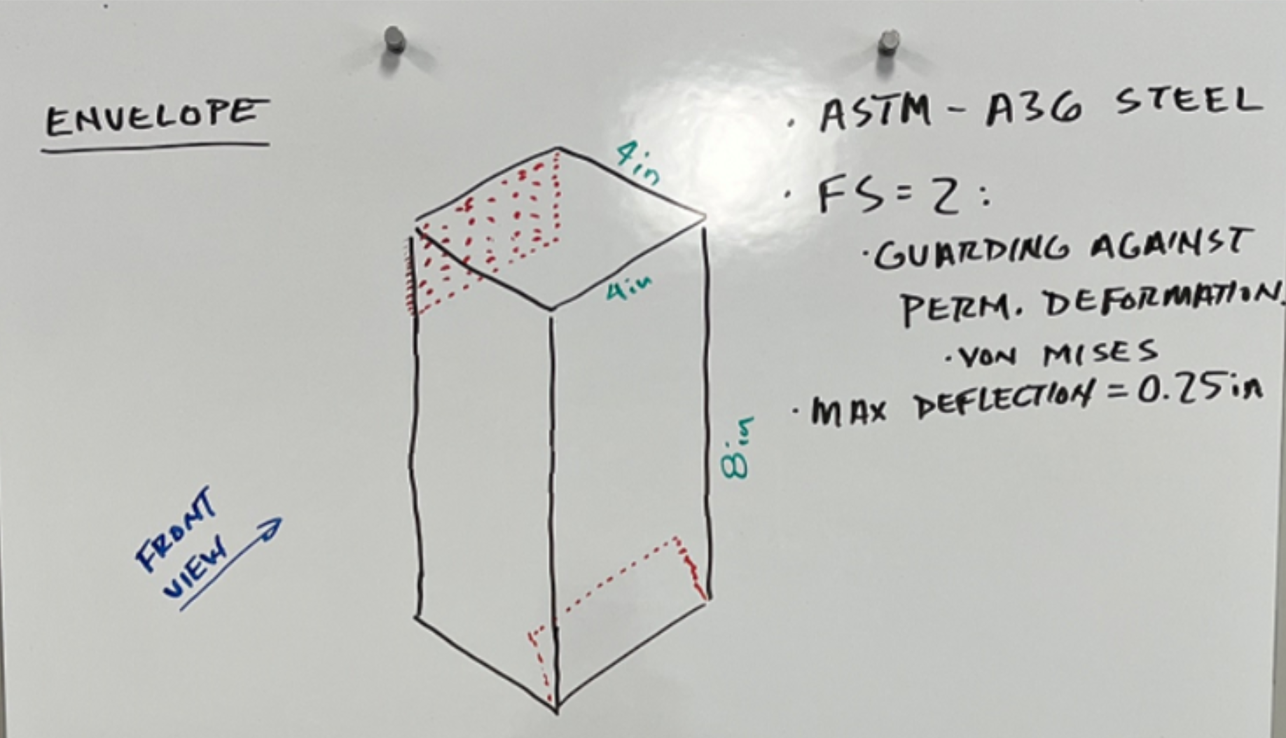
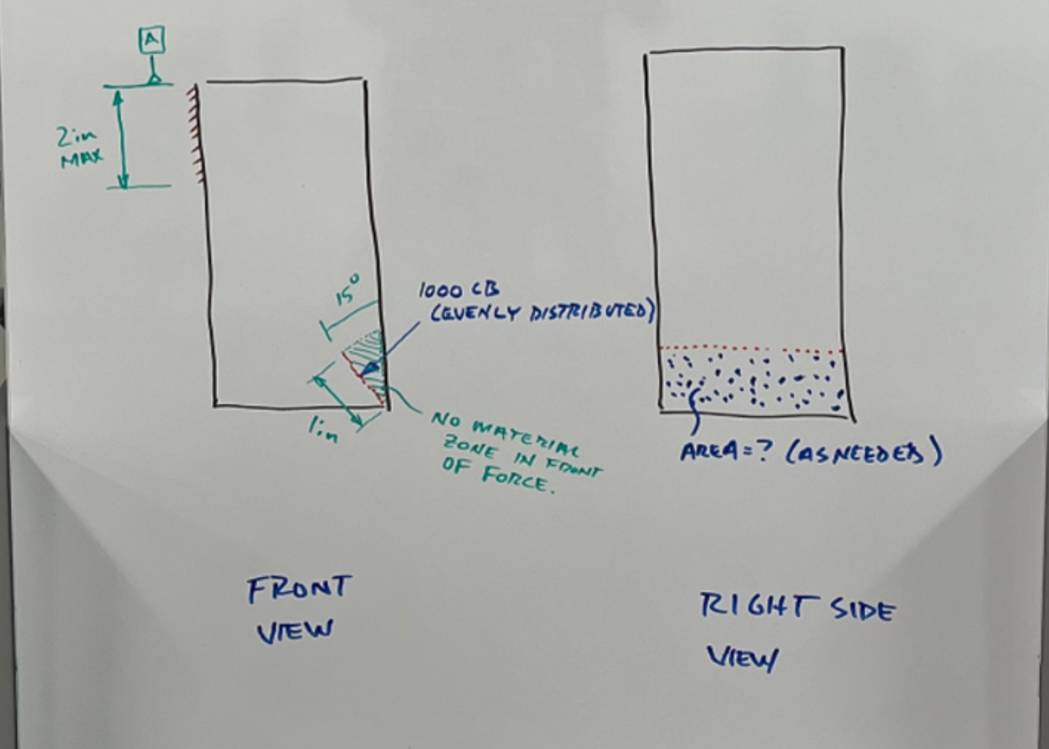
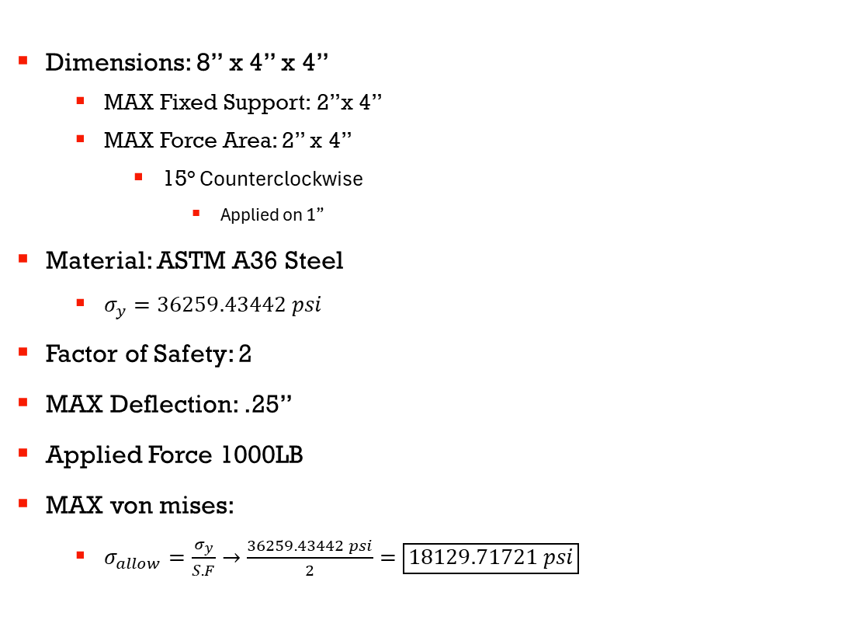
Scope
Dimensions: 8” x 4” x 4”
MAX Fixed Support: 2”x 4”
MAX Force Area: 2” x 4”
15° Counterclockwise
Applied on 1”
Material: ASTM A36 Steel
$σ_{y}=36259.43442 psi$
Factor of Safety: 2
MAX Deflection: .25”
Applied Force 1000LB
MAX von mises:
$σ_{allow}=\frac{σ_{y}}{S.F}→\frac{36259.43442 psi}{2}=\boxed{18129.71721 psi}$

Slide 3
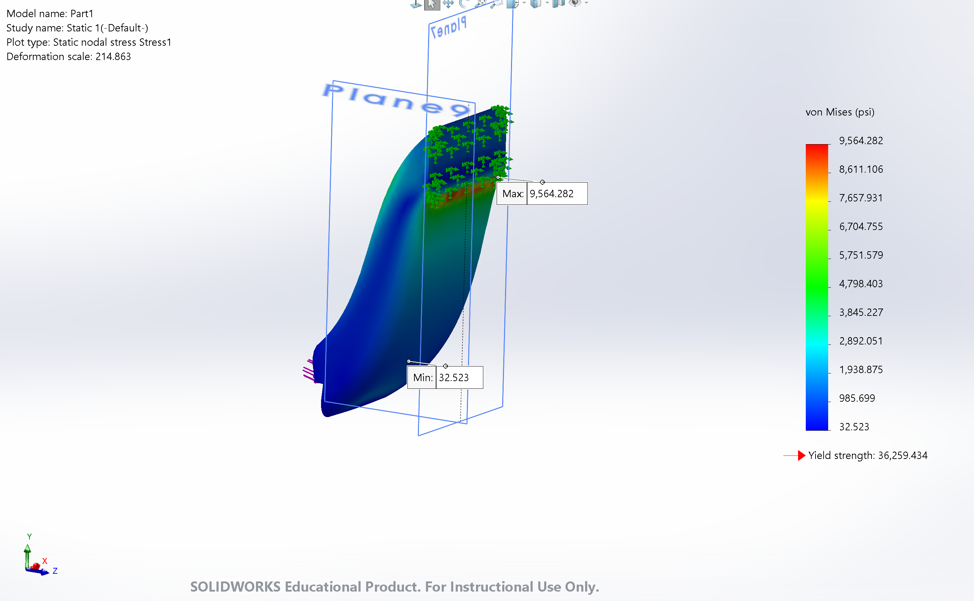
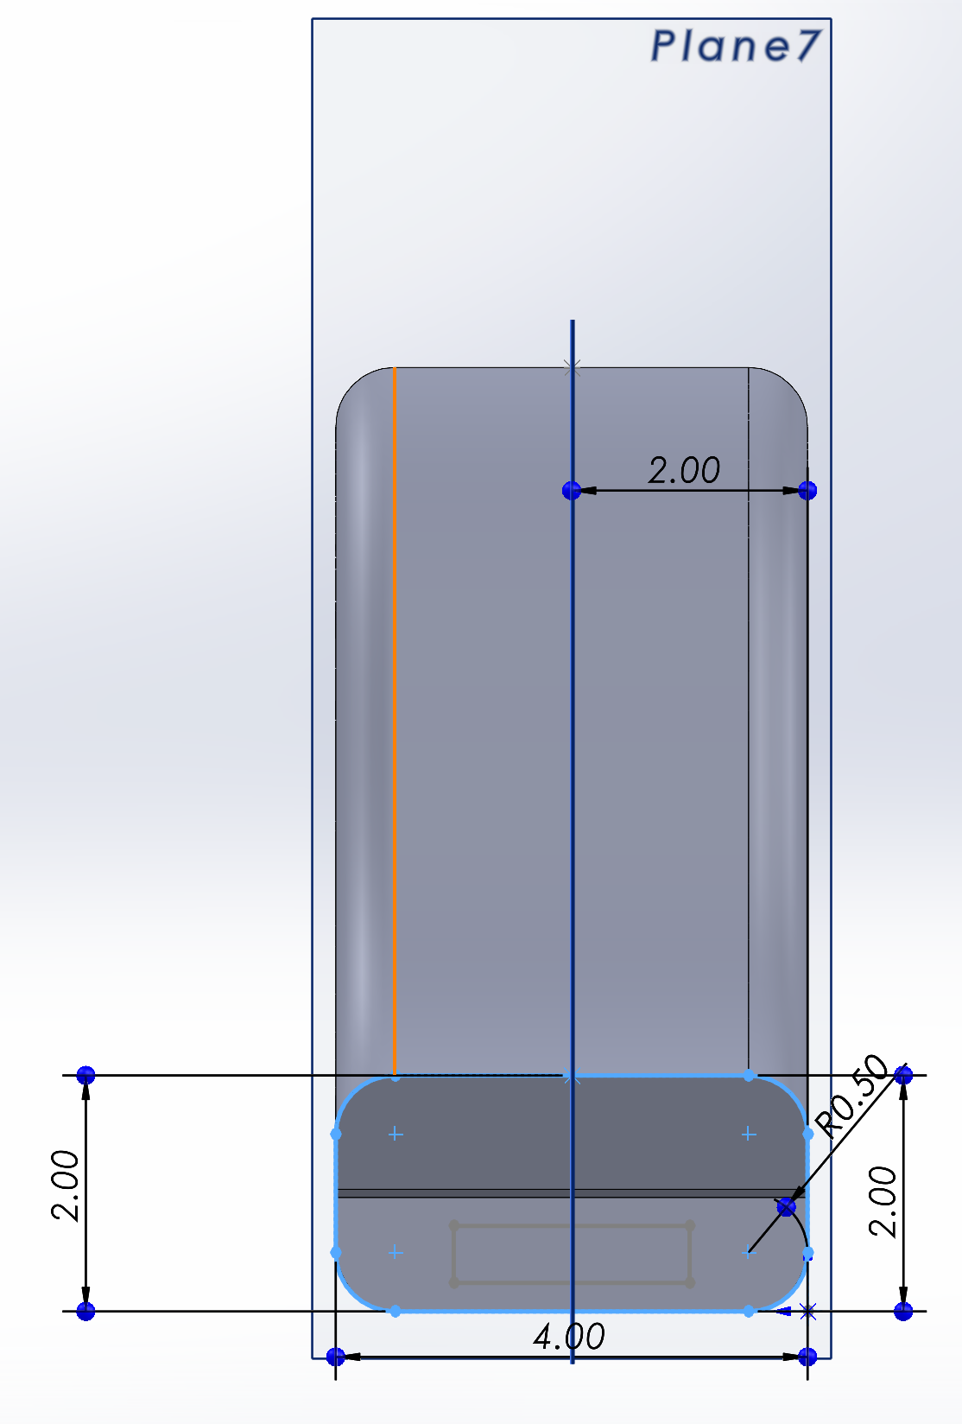
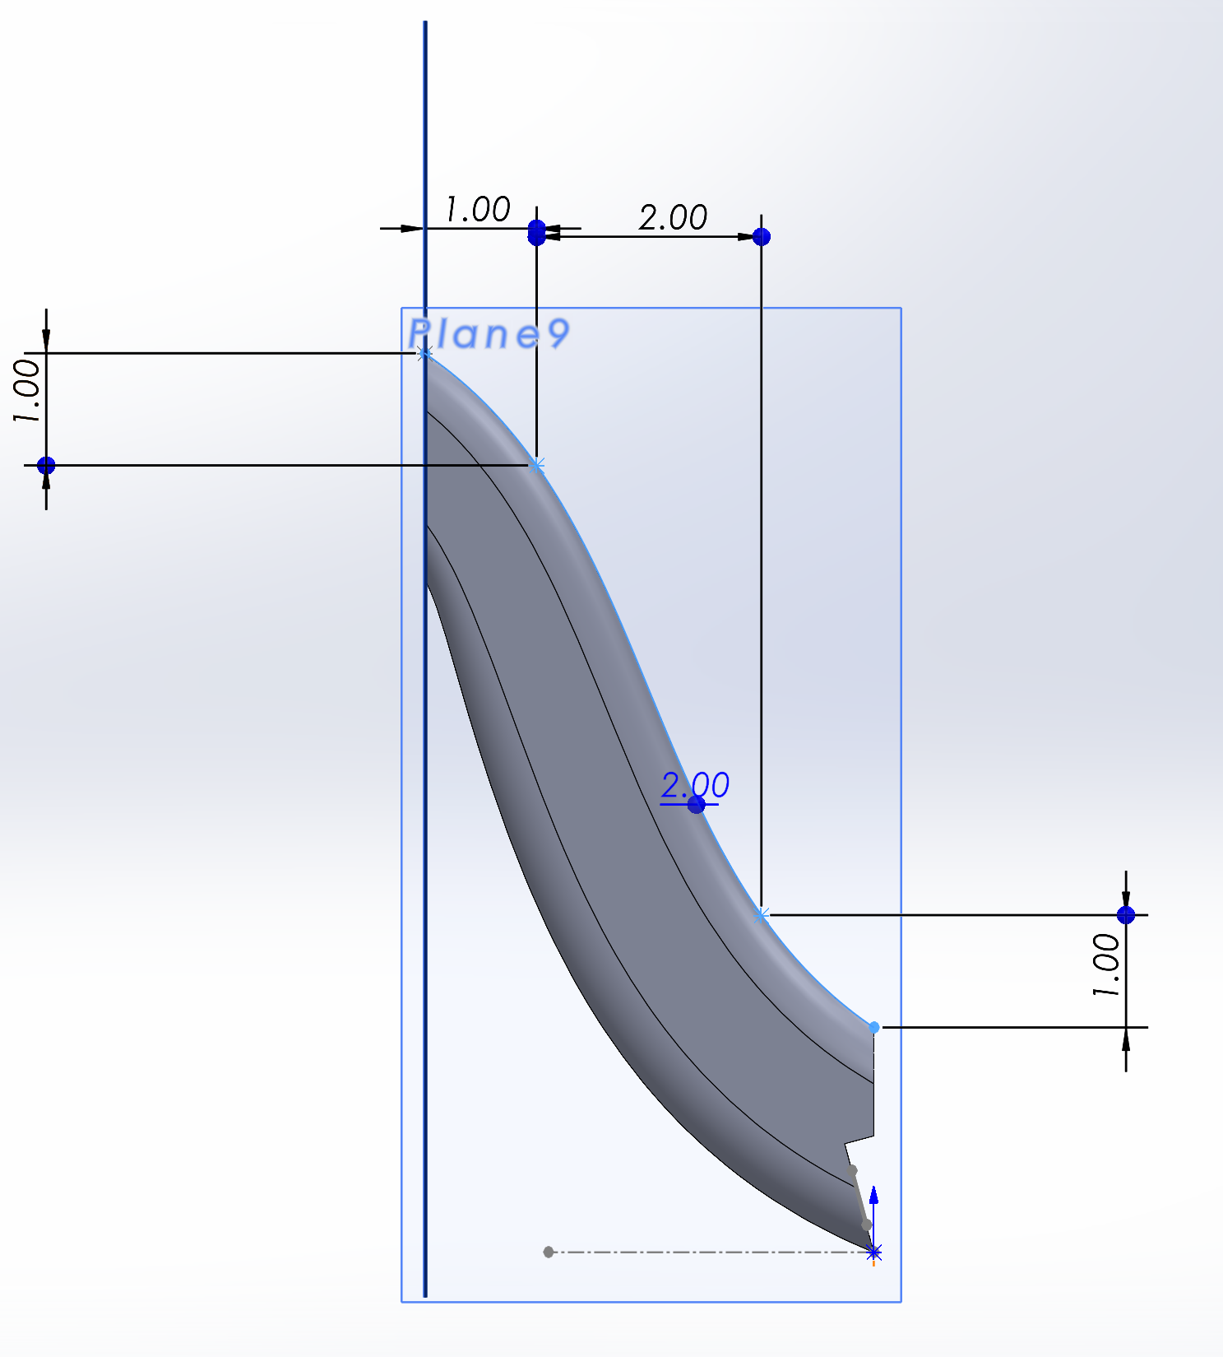
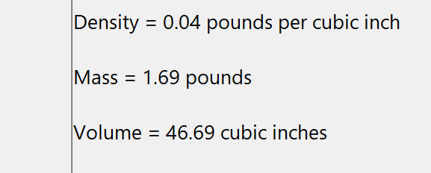
Attempt 1:
Original Baseline Design
Implemented Fillet
.5”
Boss/ Base Extrusion
Design meets specs

Slide 4
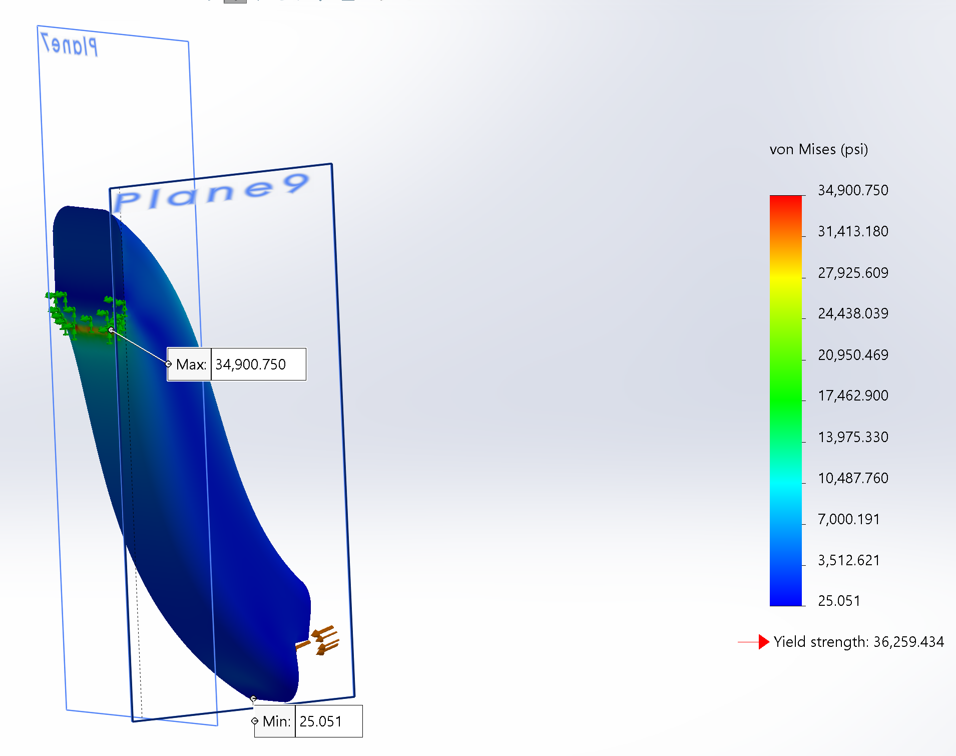
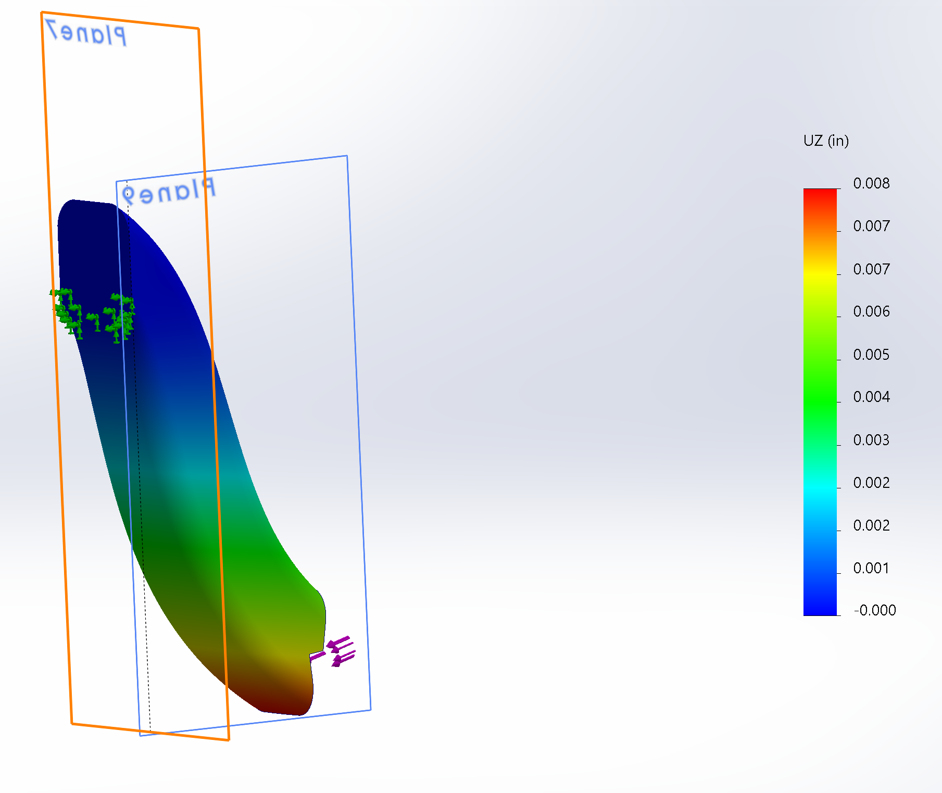
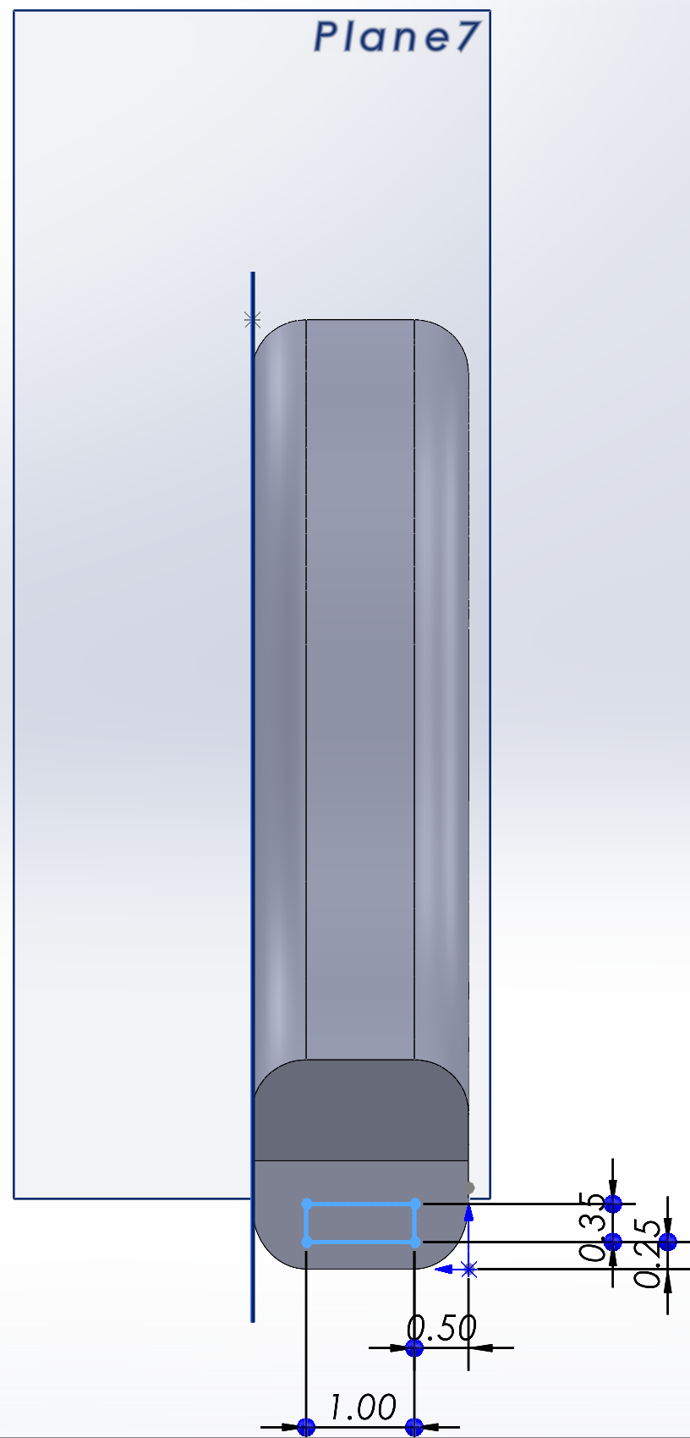
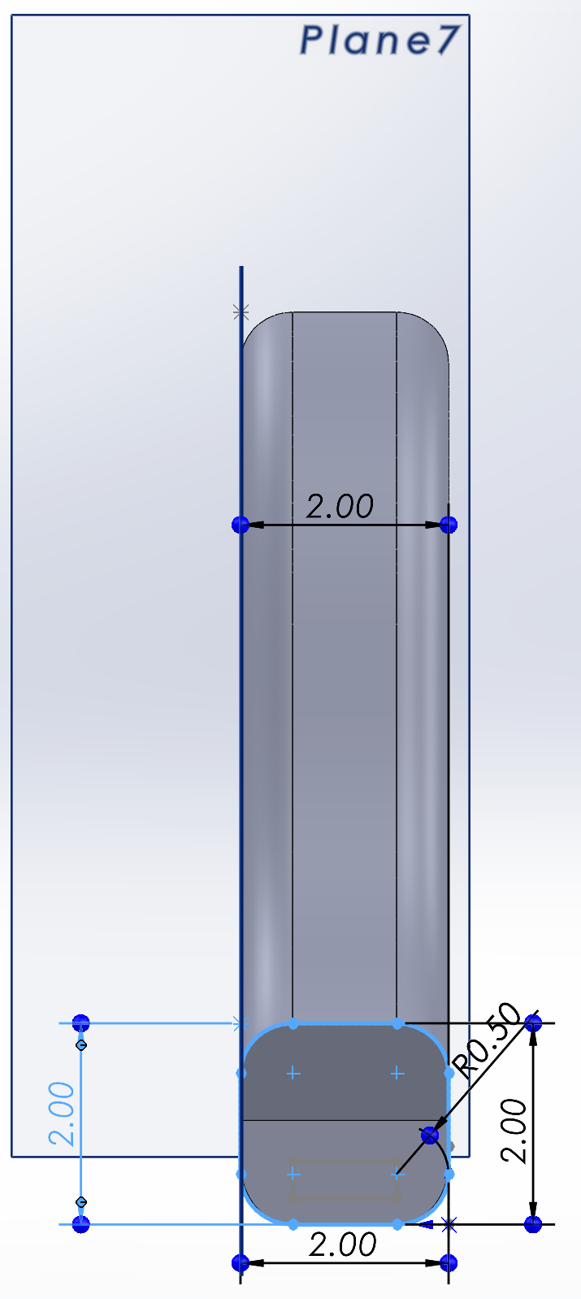
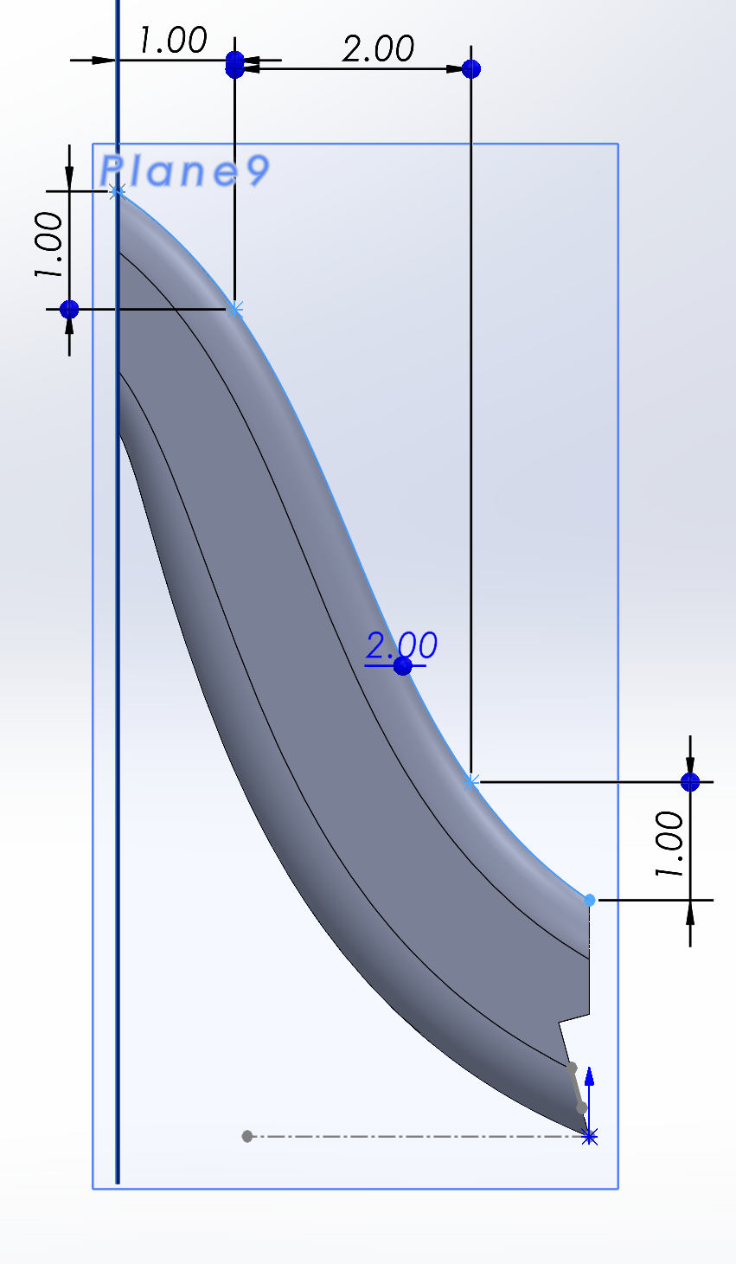
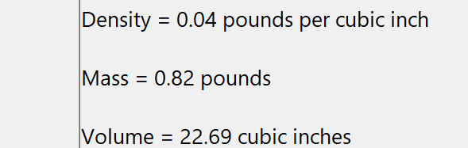
Attempt 2:
Change of Boss/ Base extrusion
Dimensions:
2” x 2” Area
Fixed Support
Force Area
Design OUT of Spec
Von Mises

Slide 5
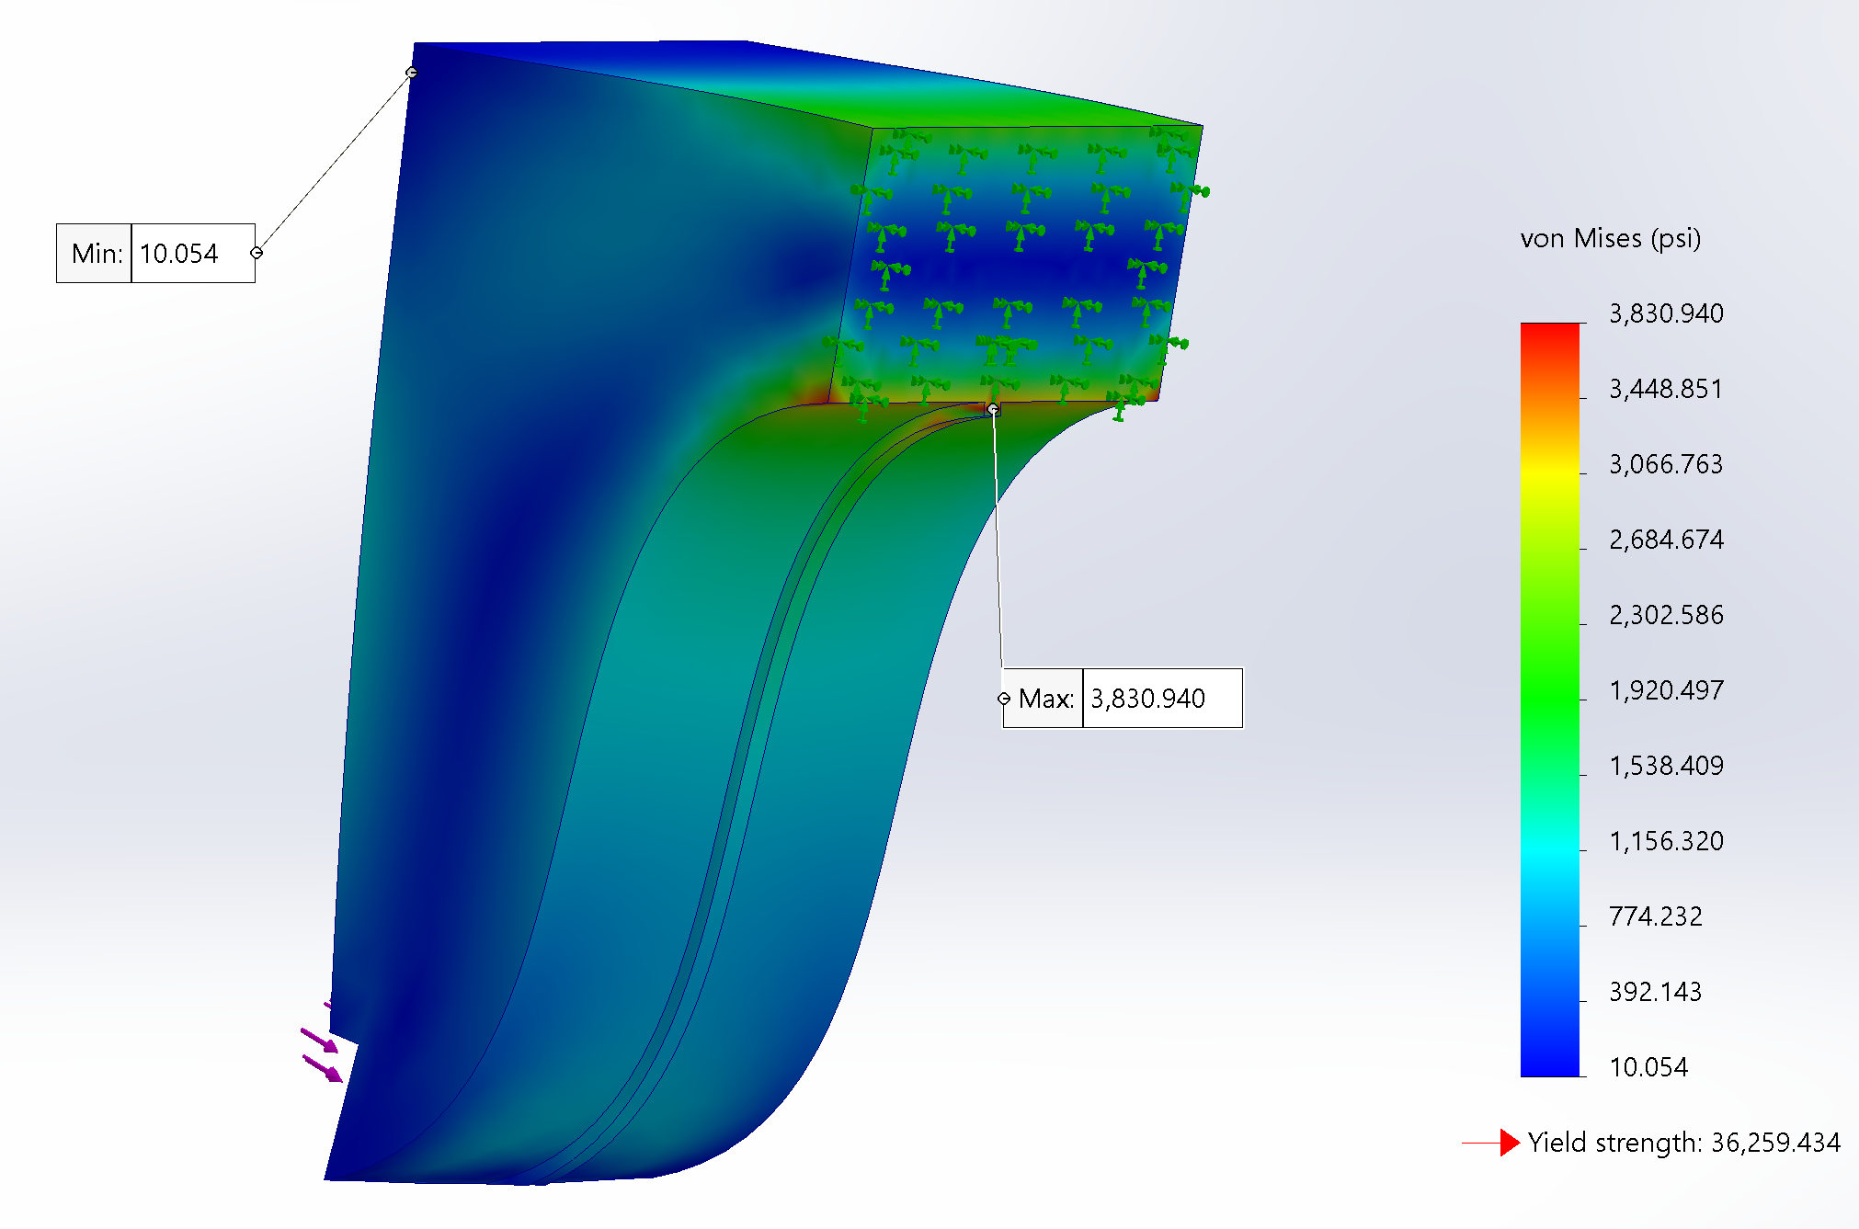
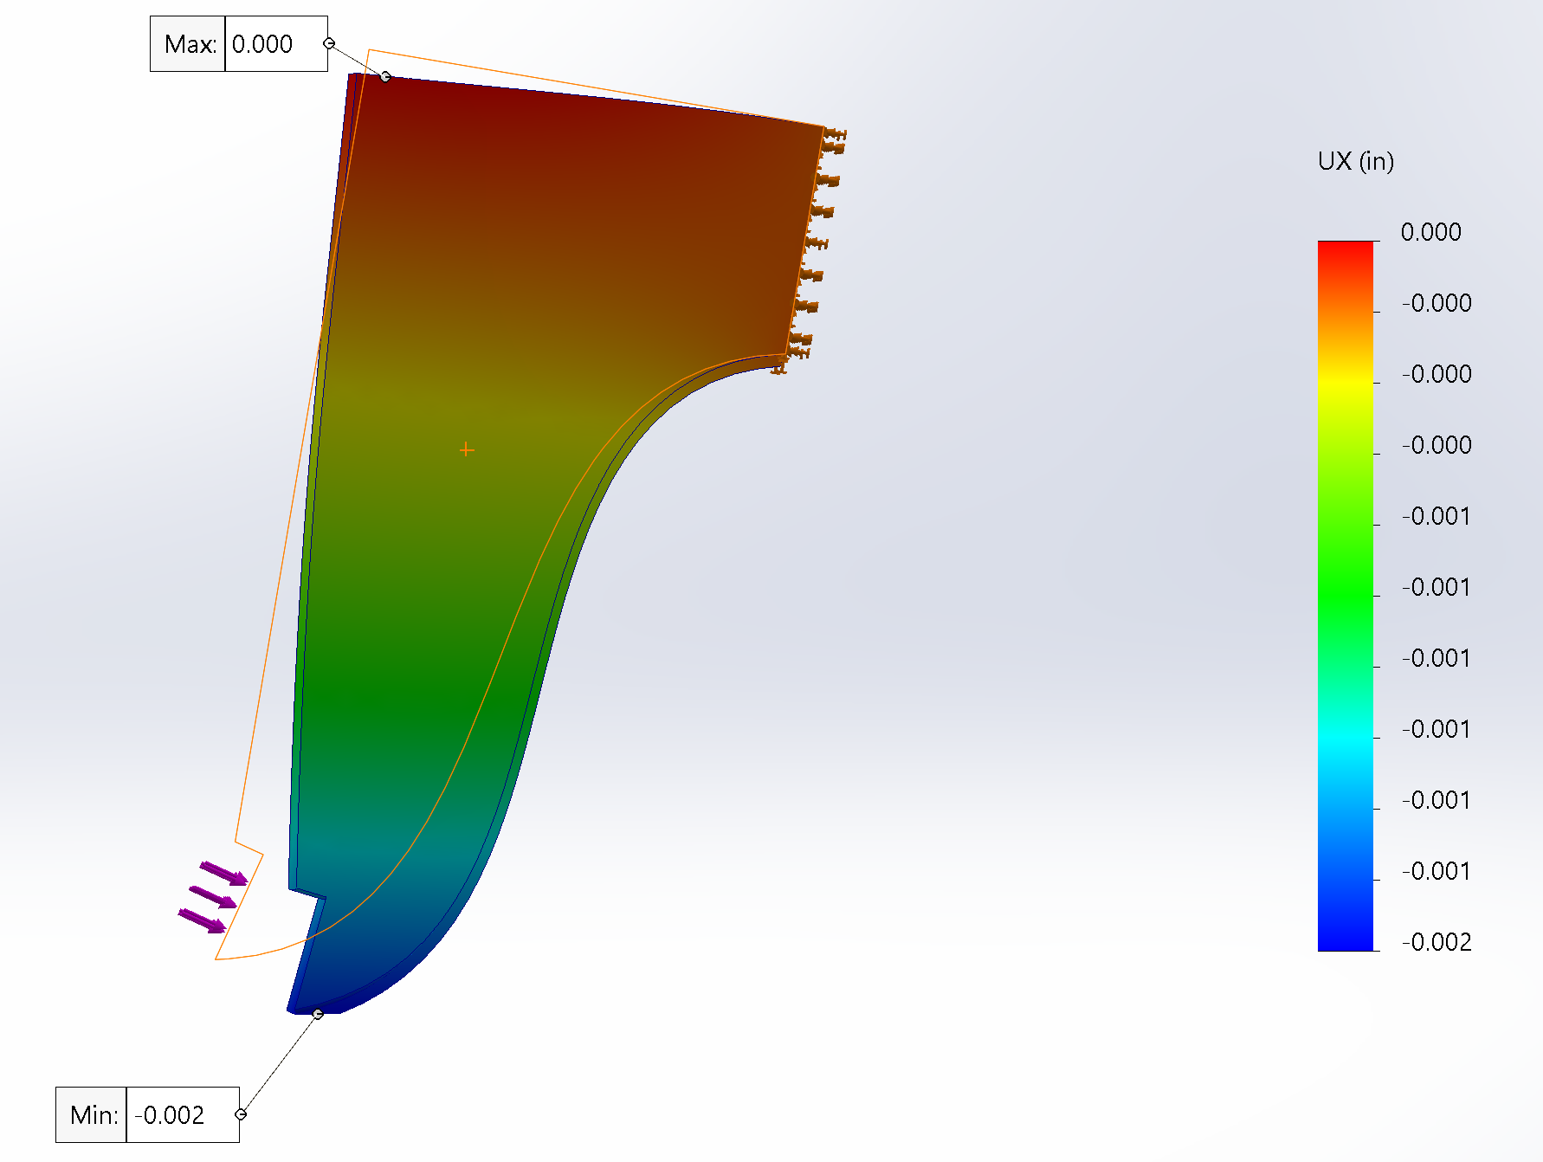
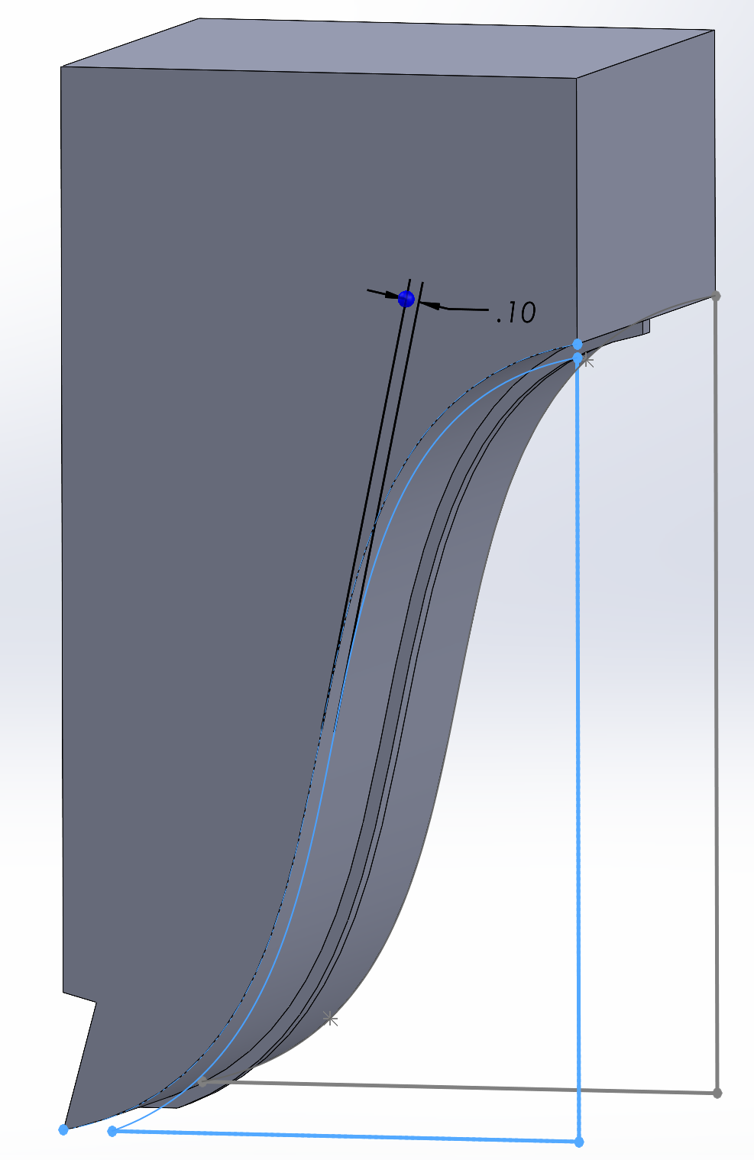
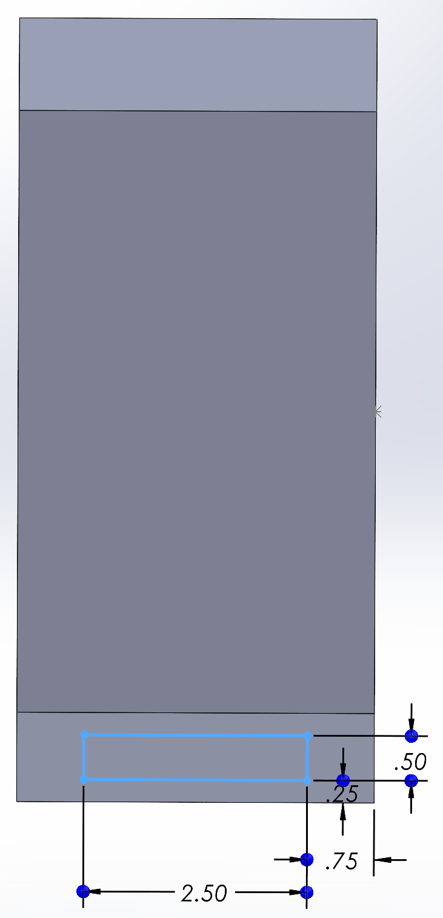
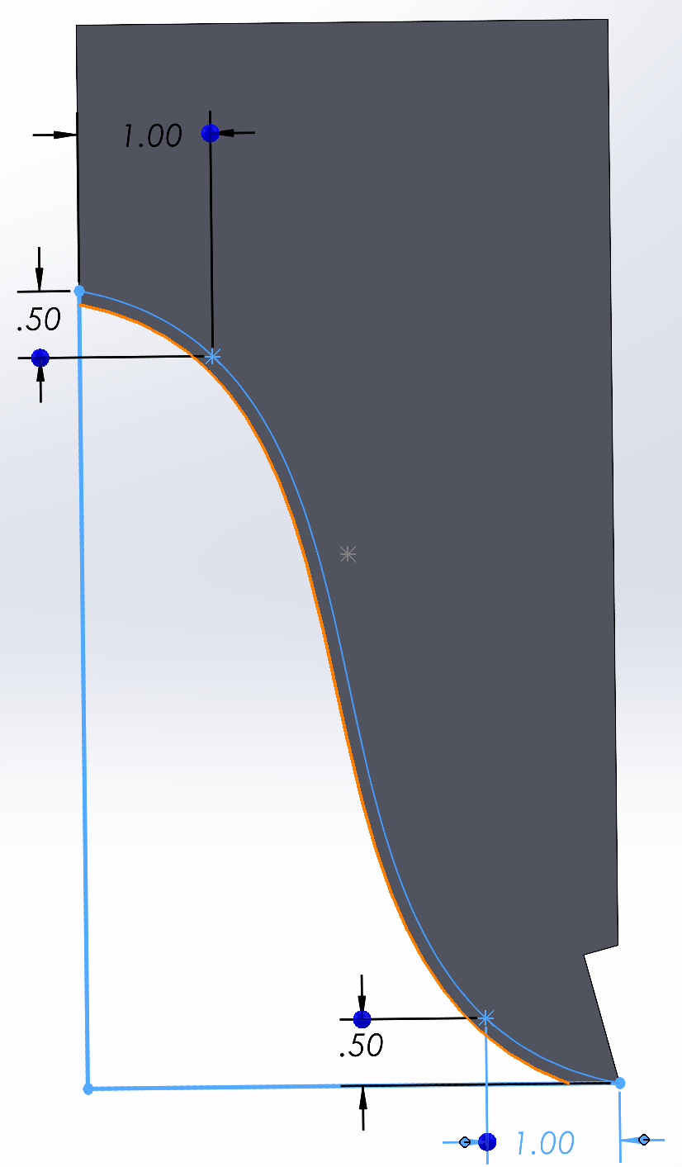
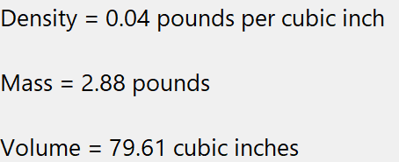
Attempt 3:
Design Change
“Support Spline Rib”
Design meets specs

Slide 6
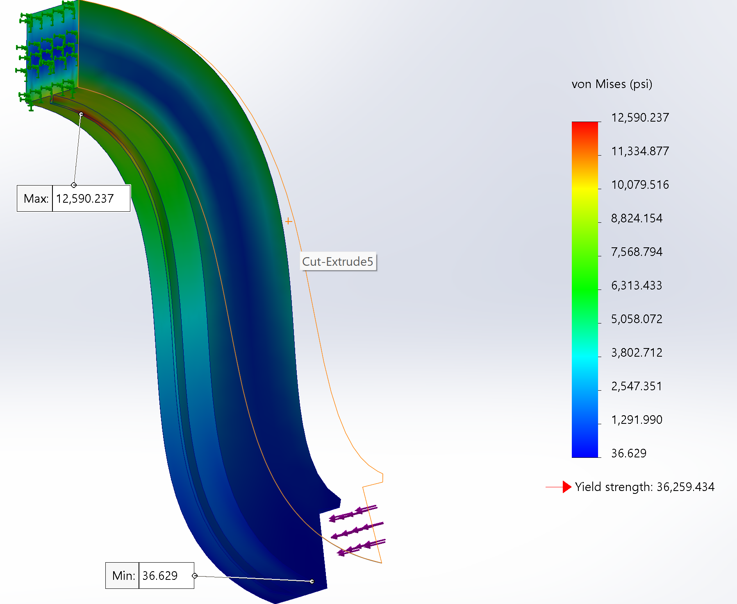
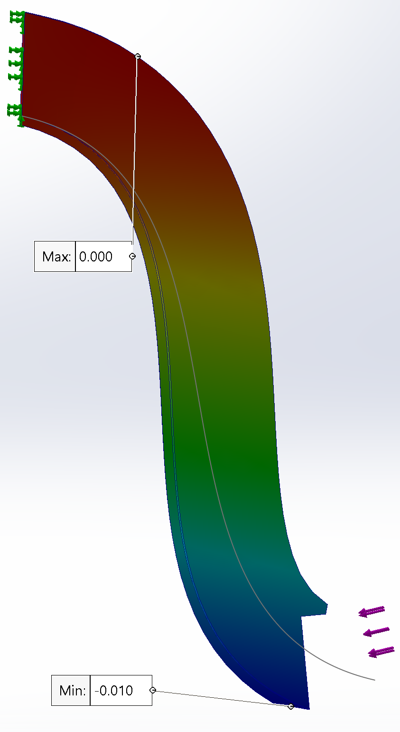
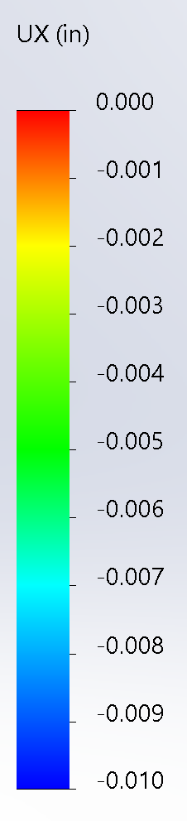
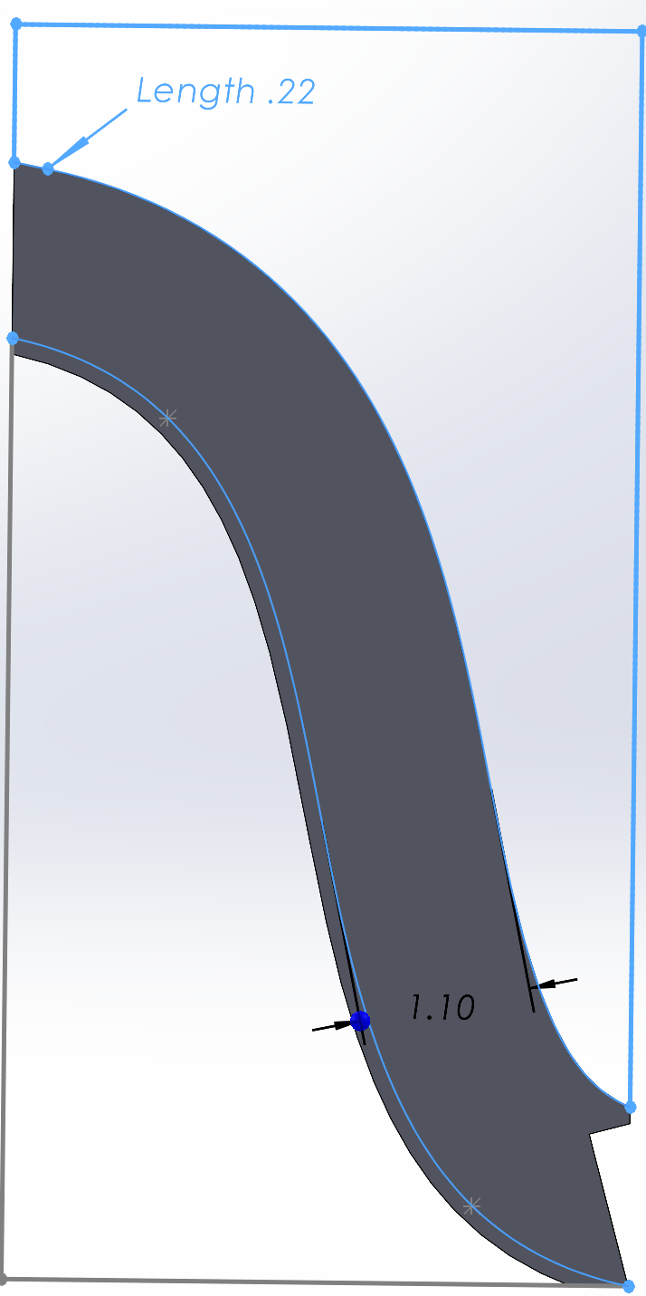
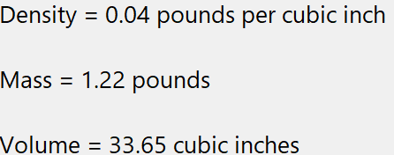
Attempt 4:
Removal of Excess Material
Design meets specs

Slide 7
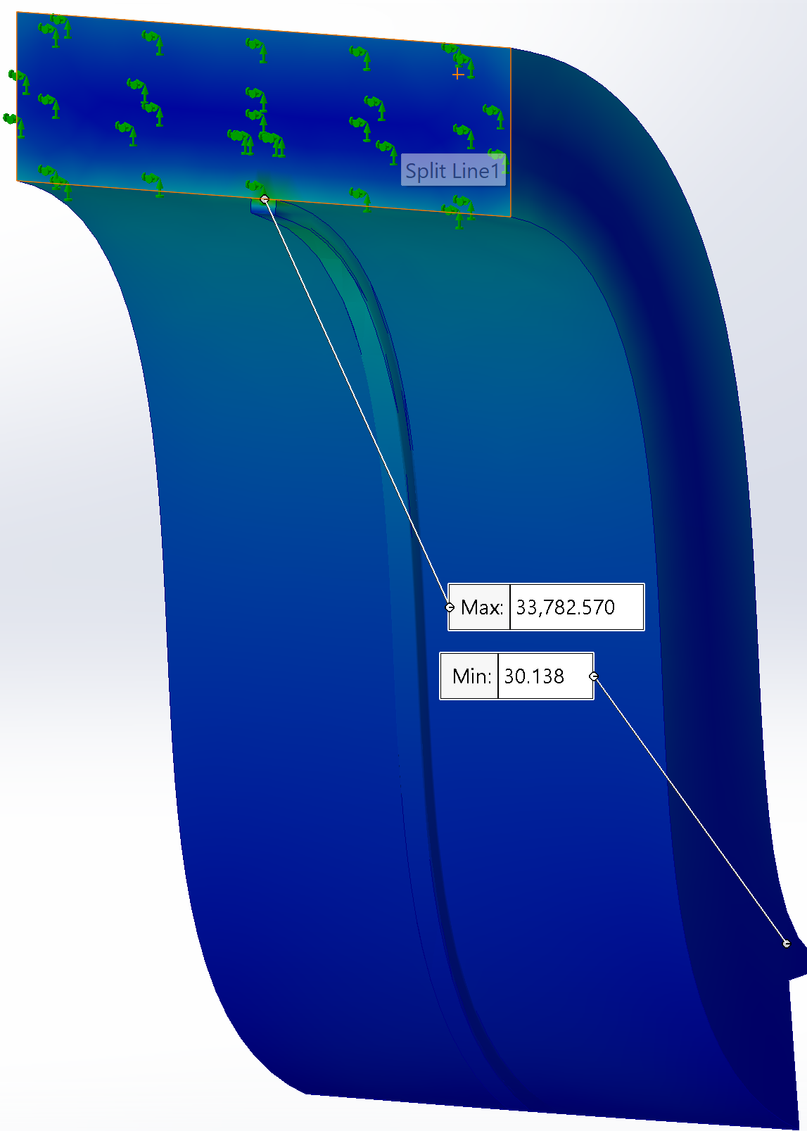
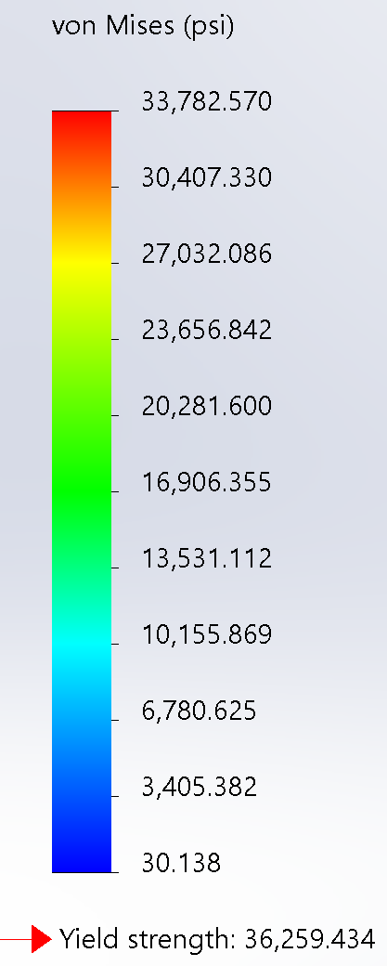
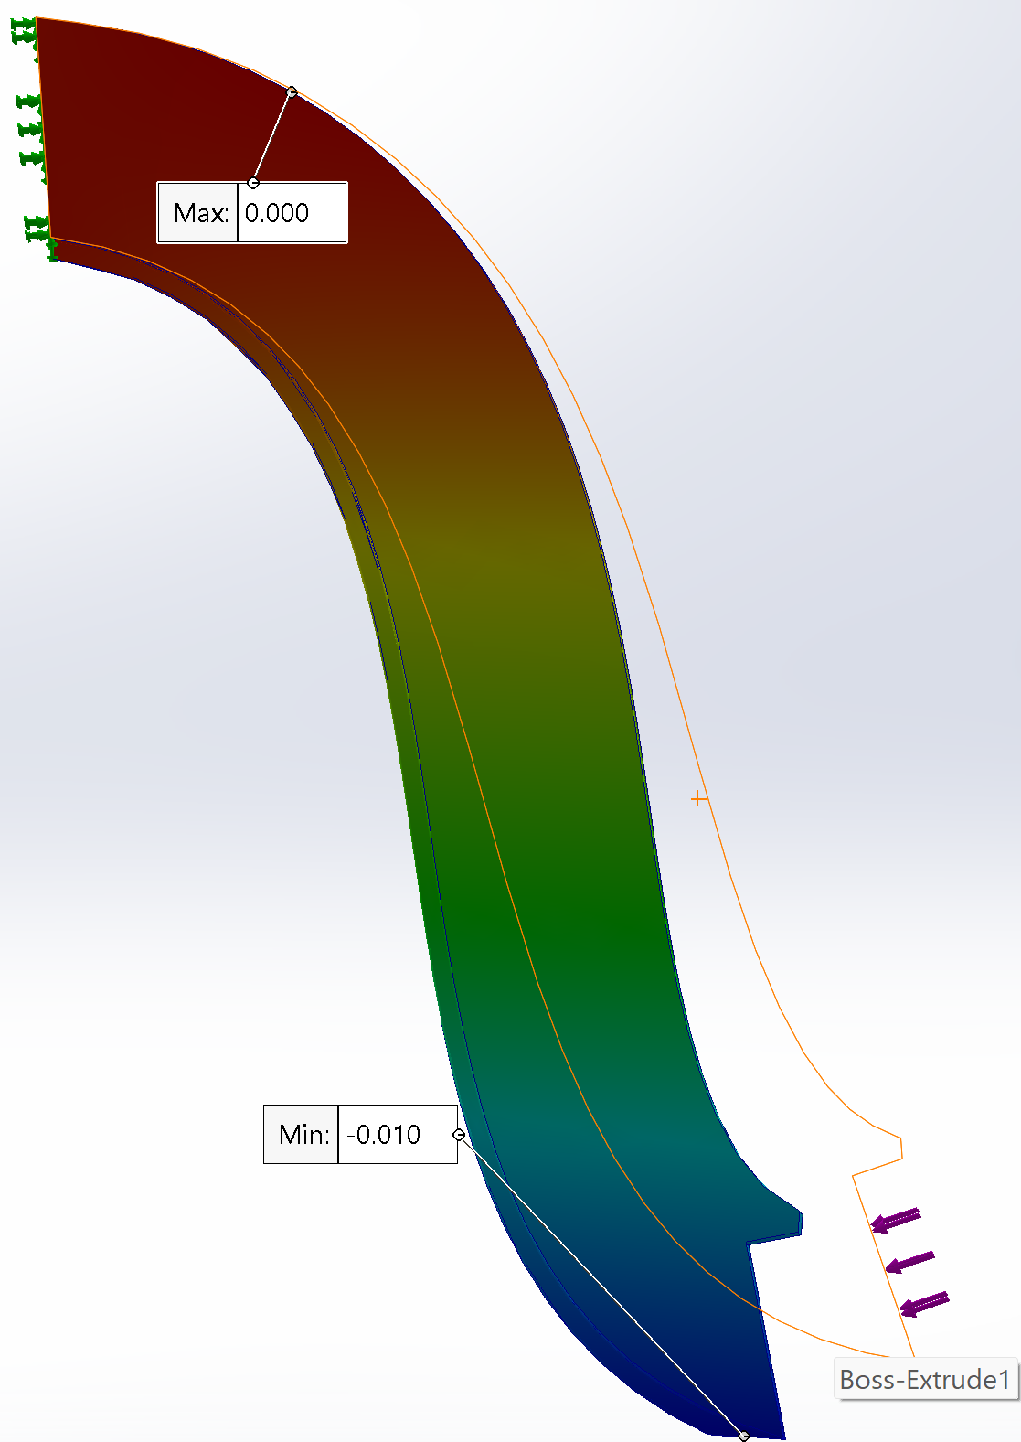
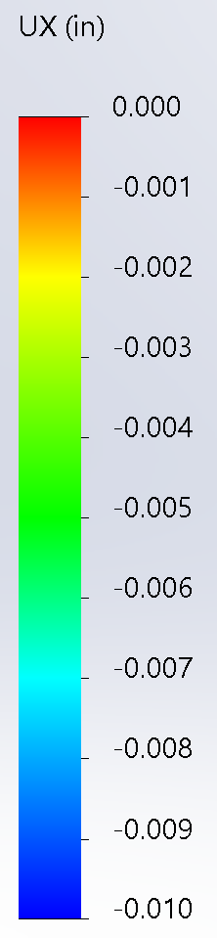
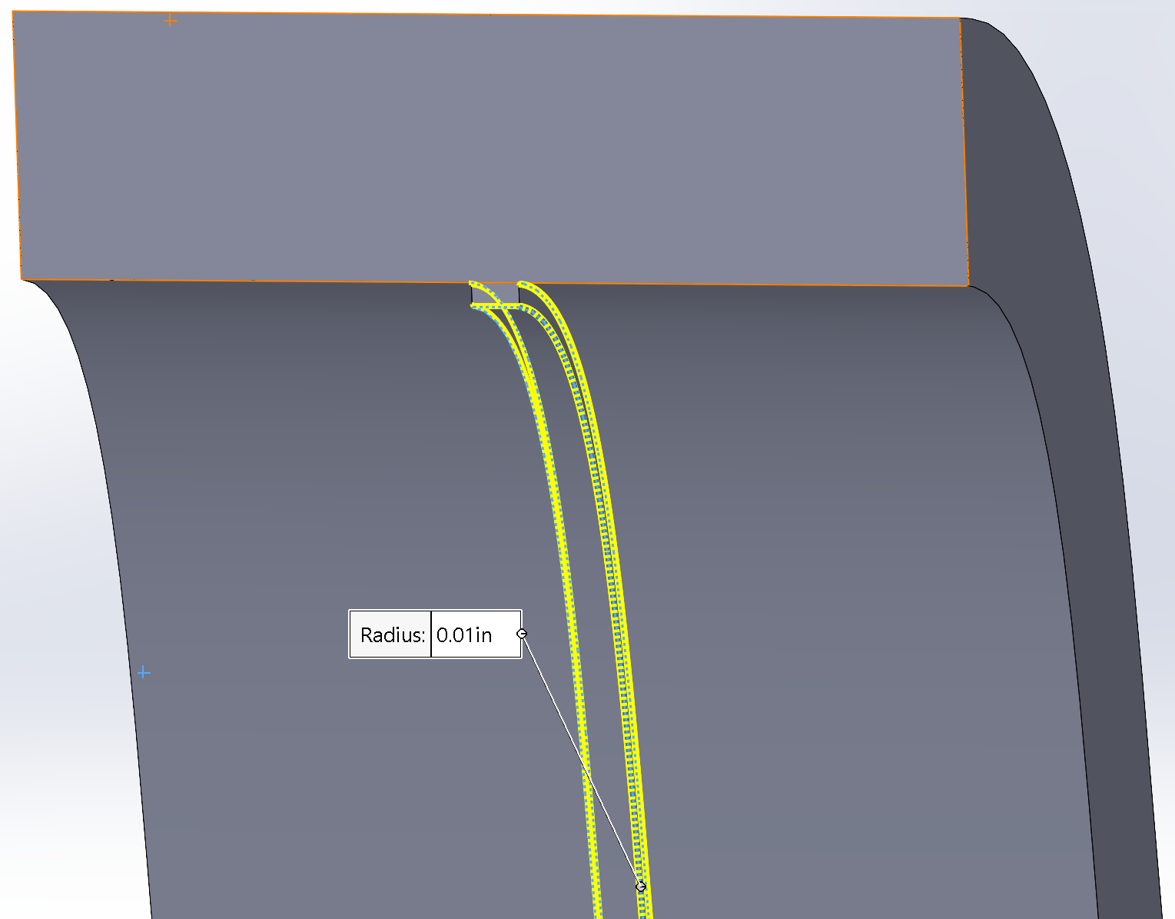
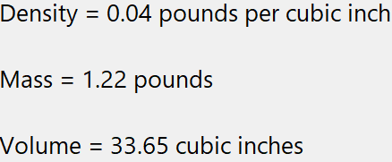
Attempt 5:
Implemented Fillet
“Support Spline Rib”
Design OUT of Spec
Von Mises
Fillet – “Friend or Foe”?

Slide 8
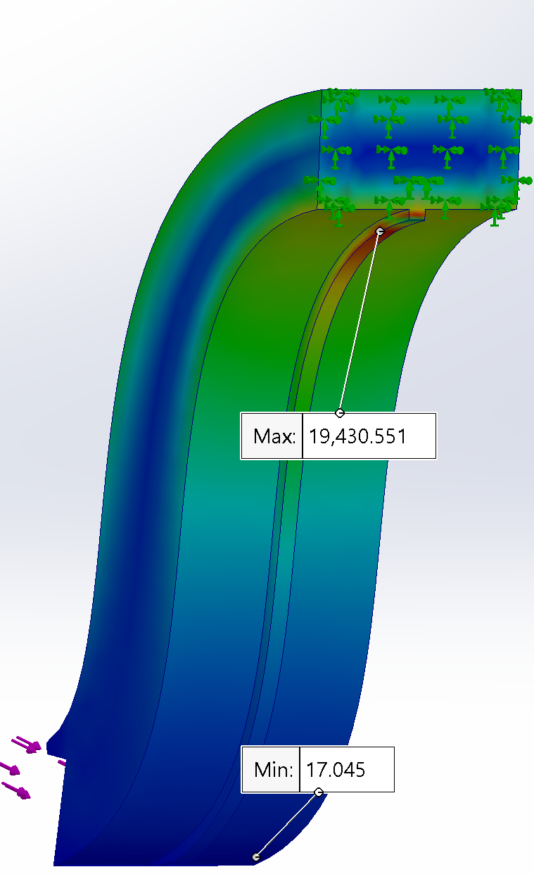
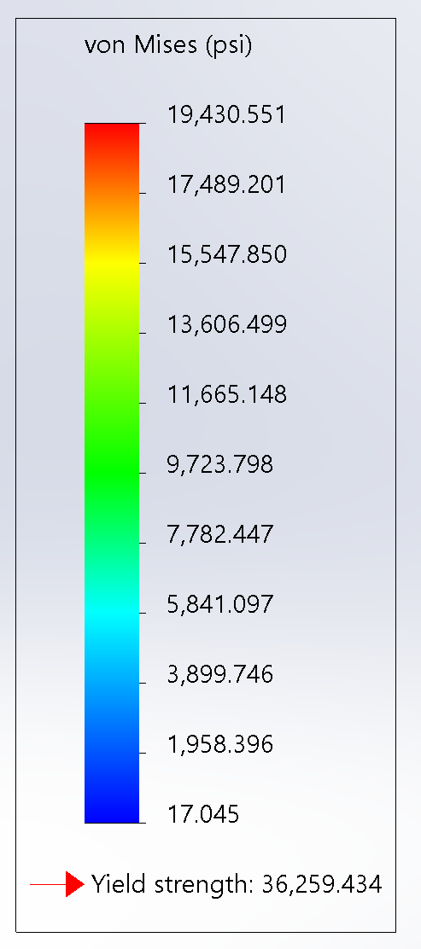
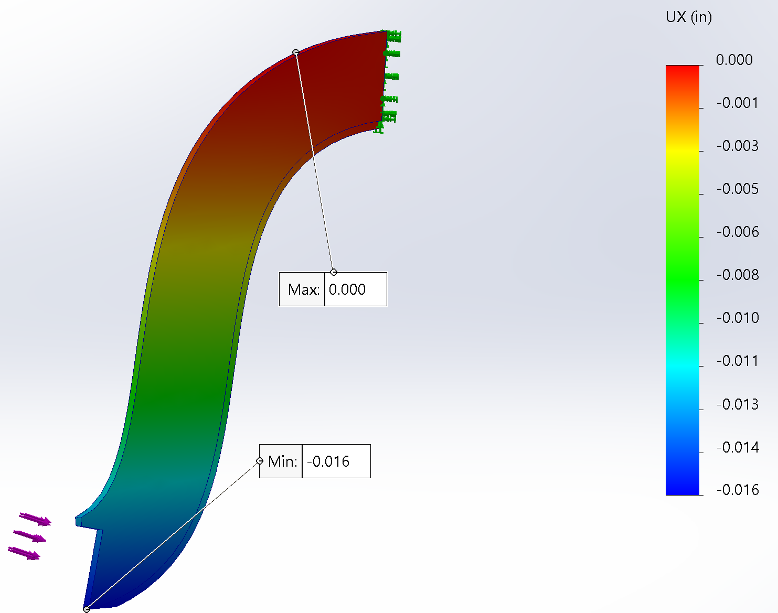
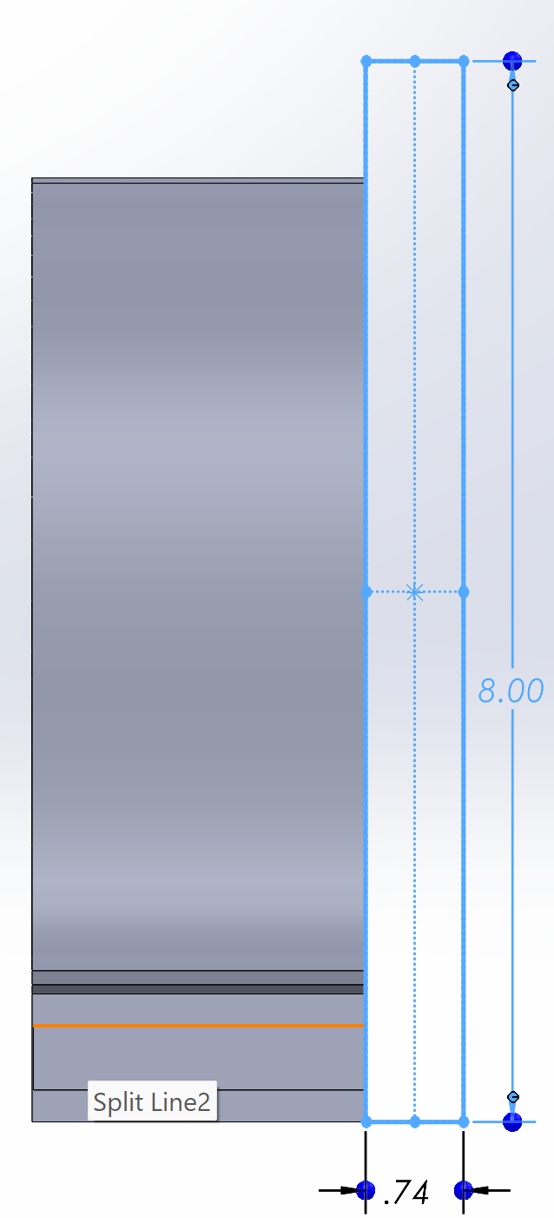
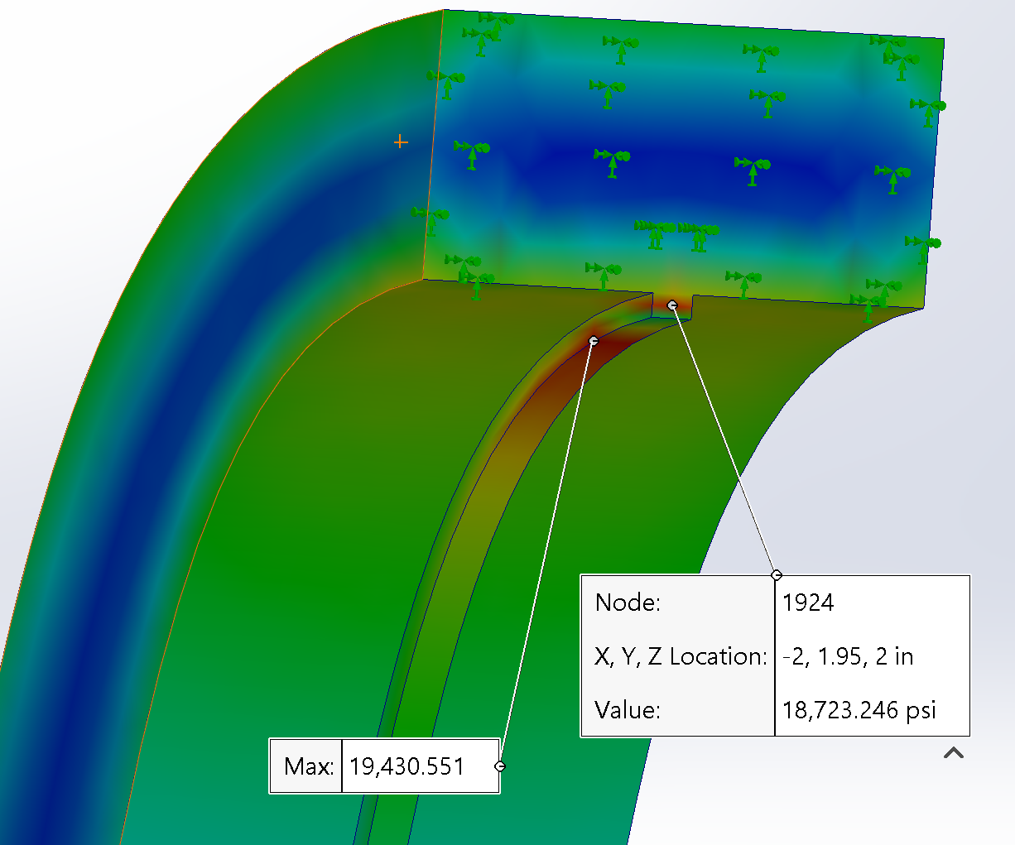
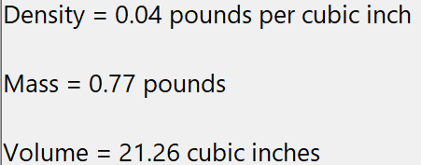
Attempt 6:
Reverted to Design “Attempt 4”
Force and Fixed Area
Removed Excess Material on Sides
Design OUT of Spec
Von Mises

Slide 9
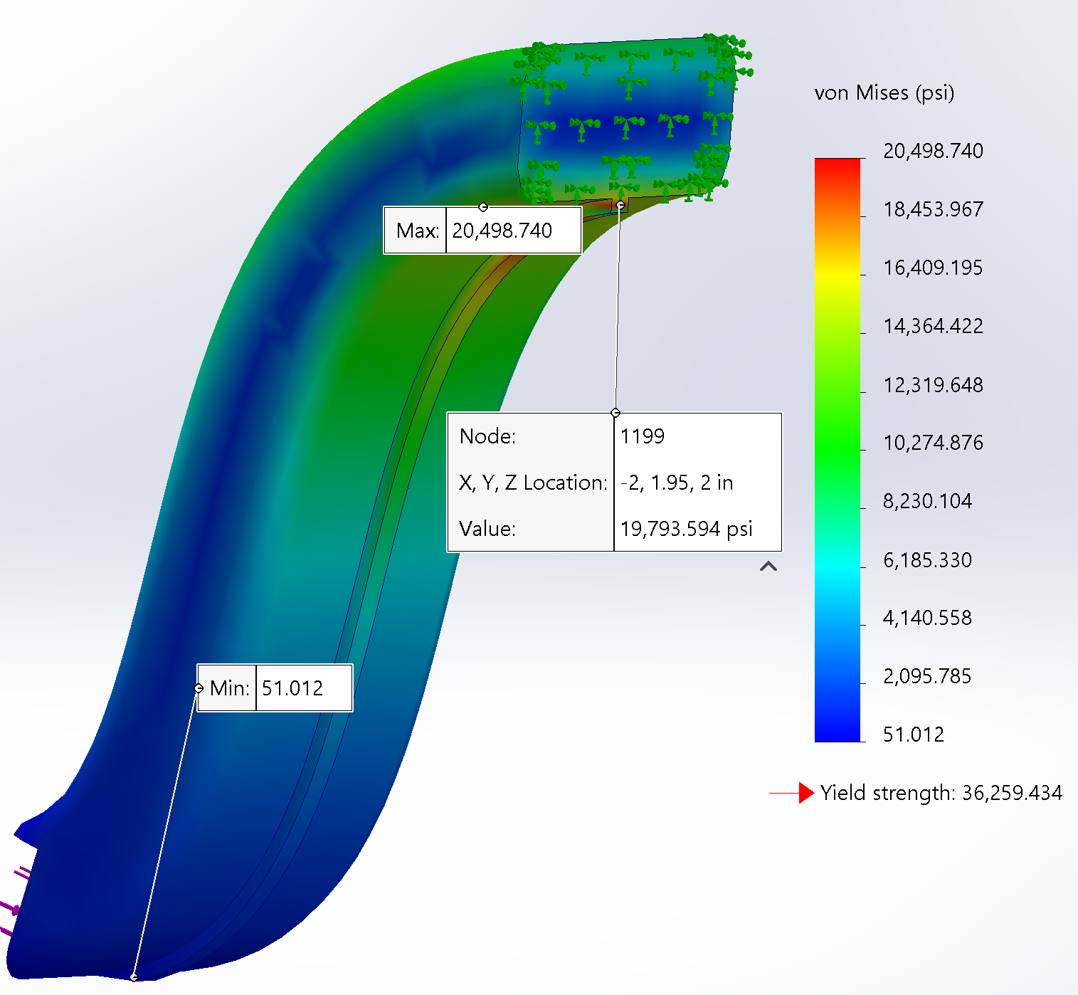
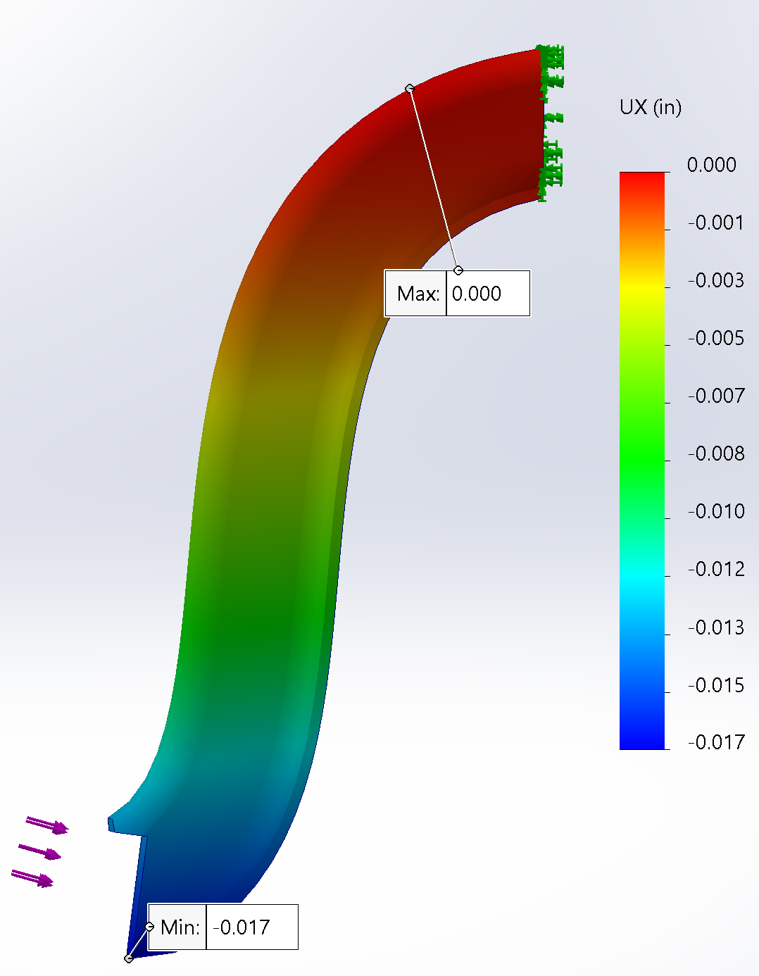
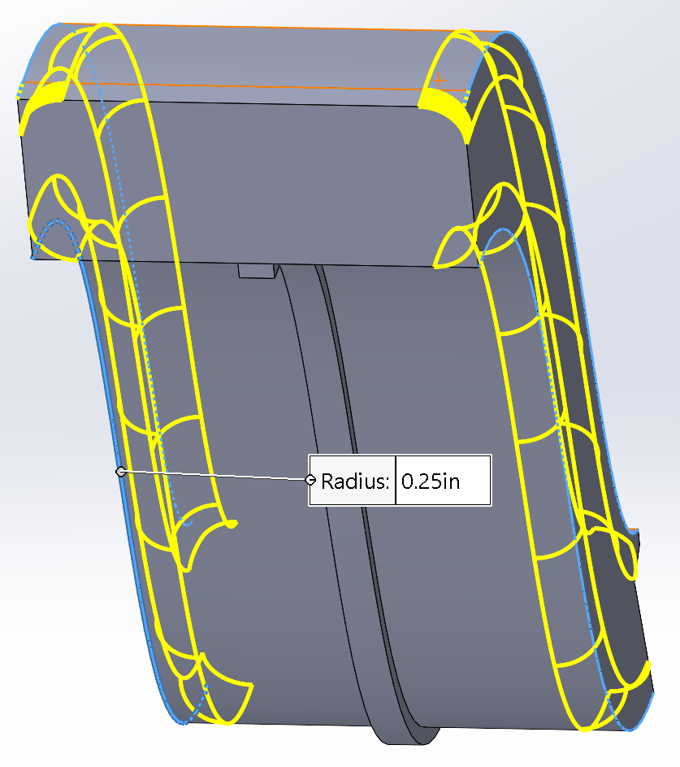
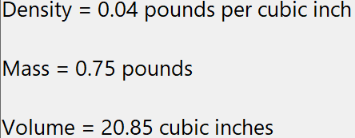
Attempt 7:
Implemented Fillet
.25”
Design OUT of Spec
Von Mises

Slide 10
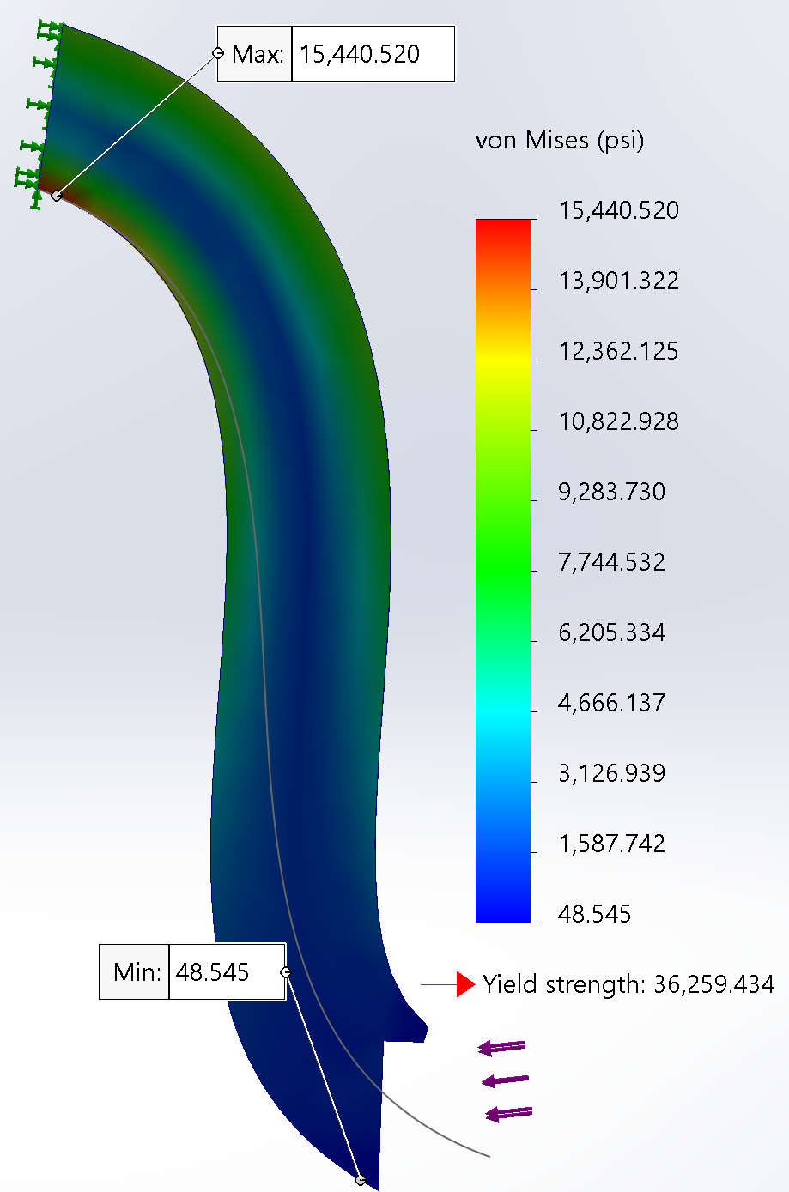
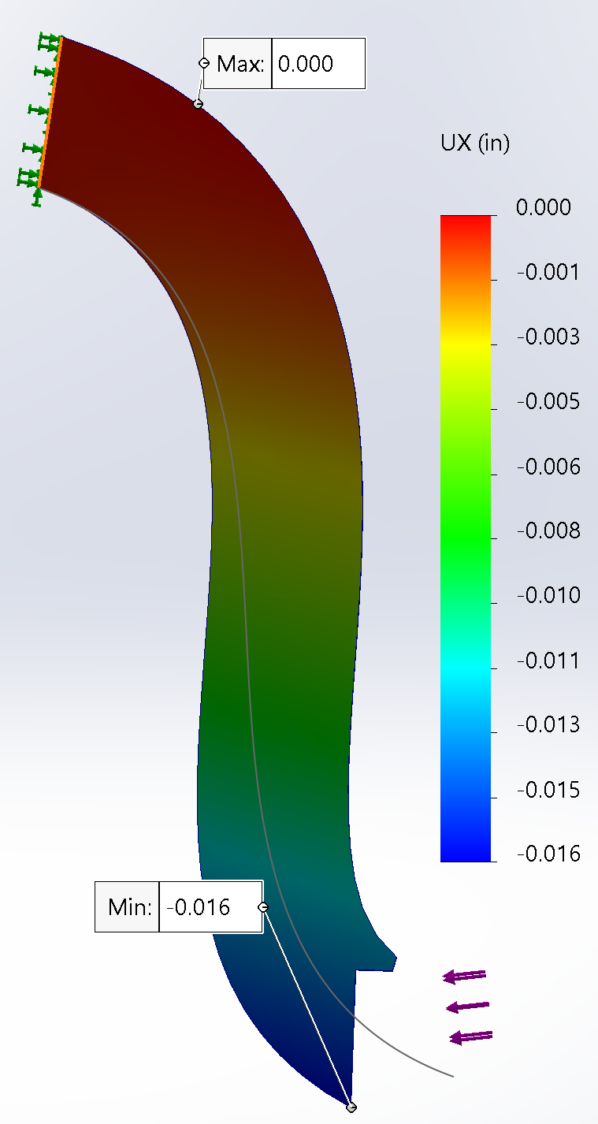
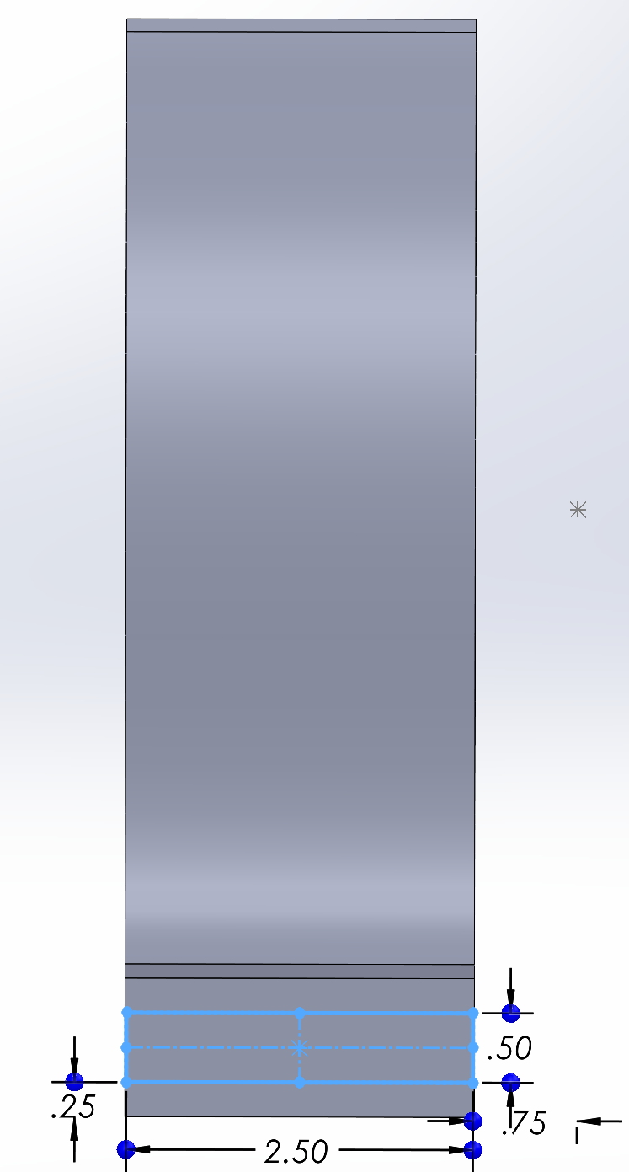
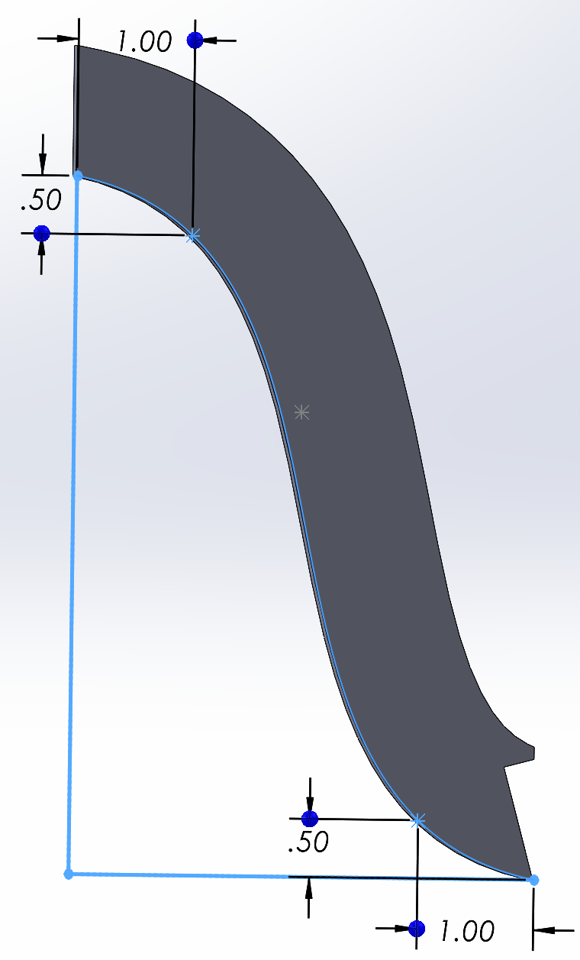
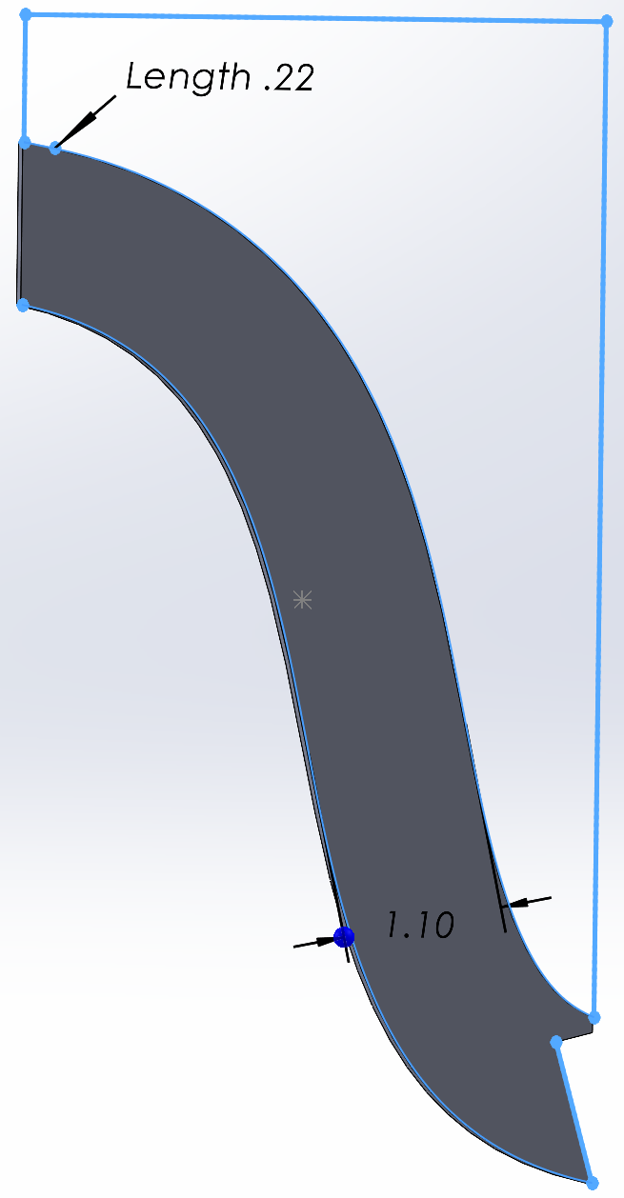
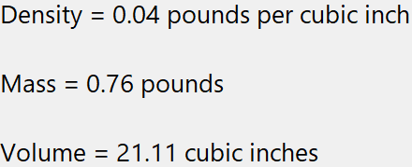
Attempt 8:
Removed “Support Spline Rib”
Design Meets Spec

Slide 11
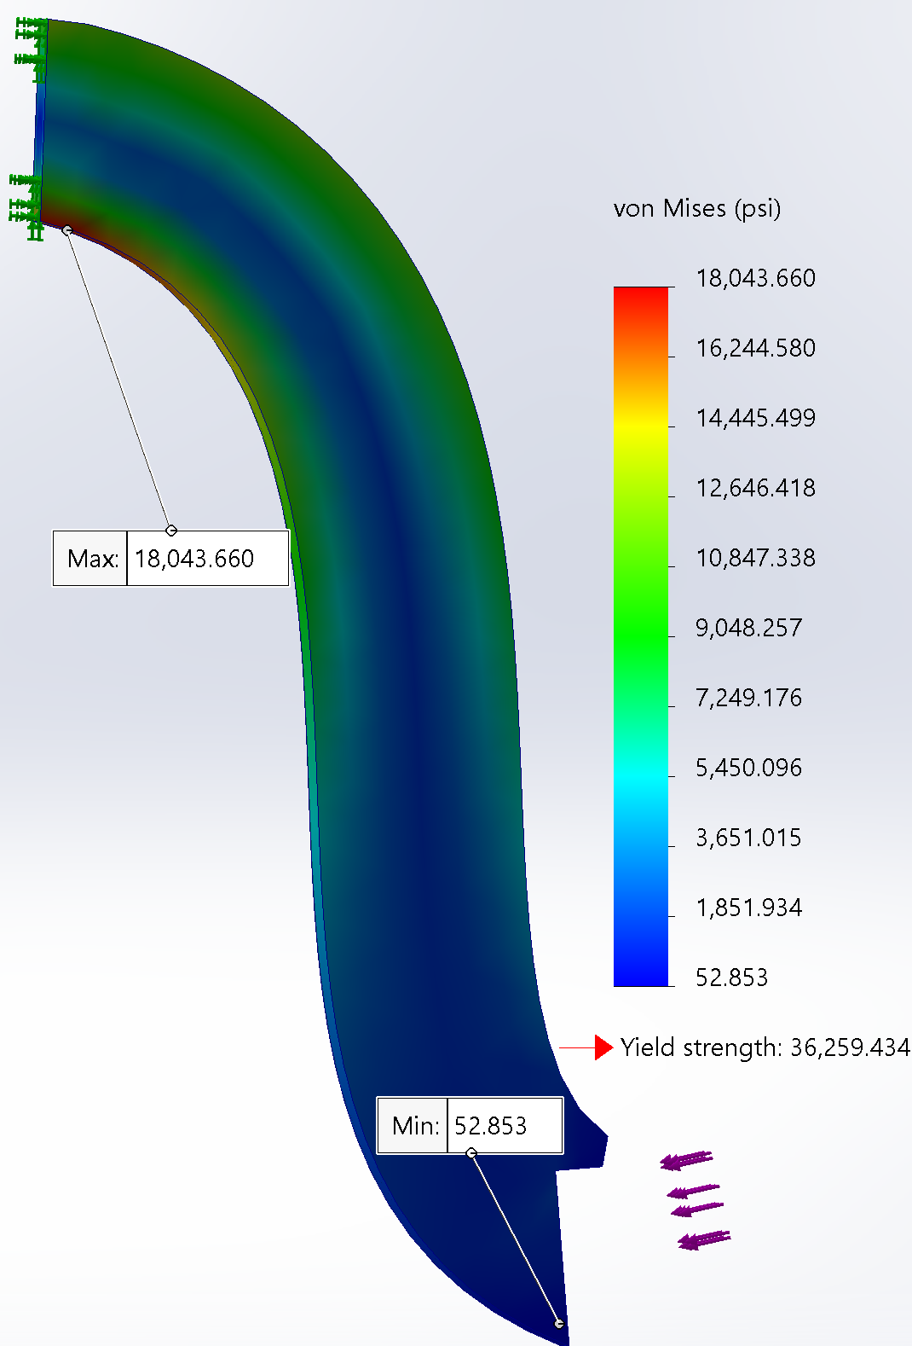
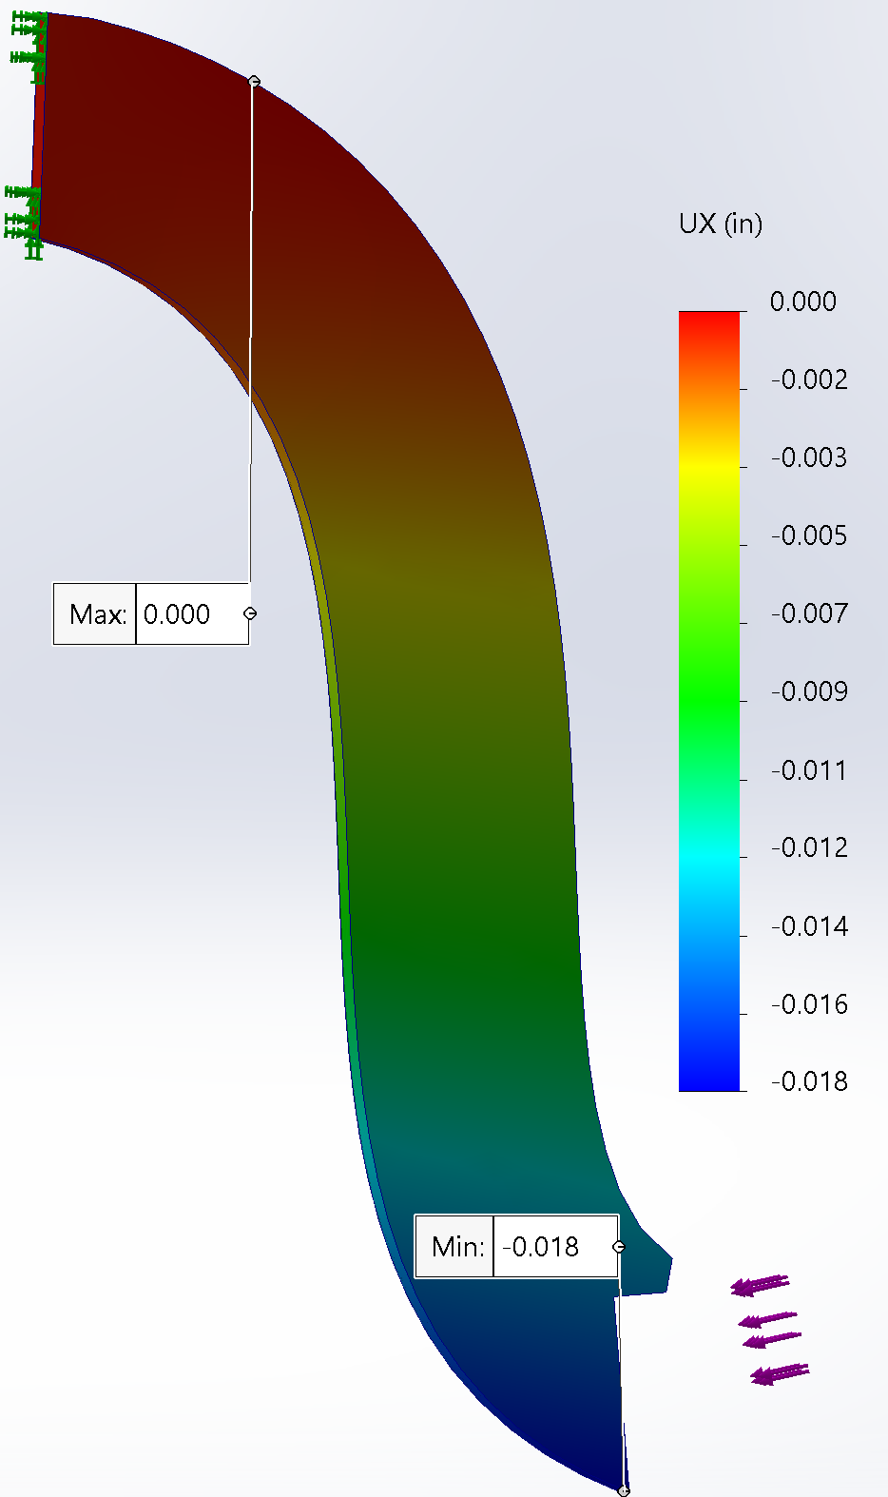
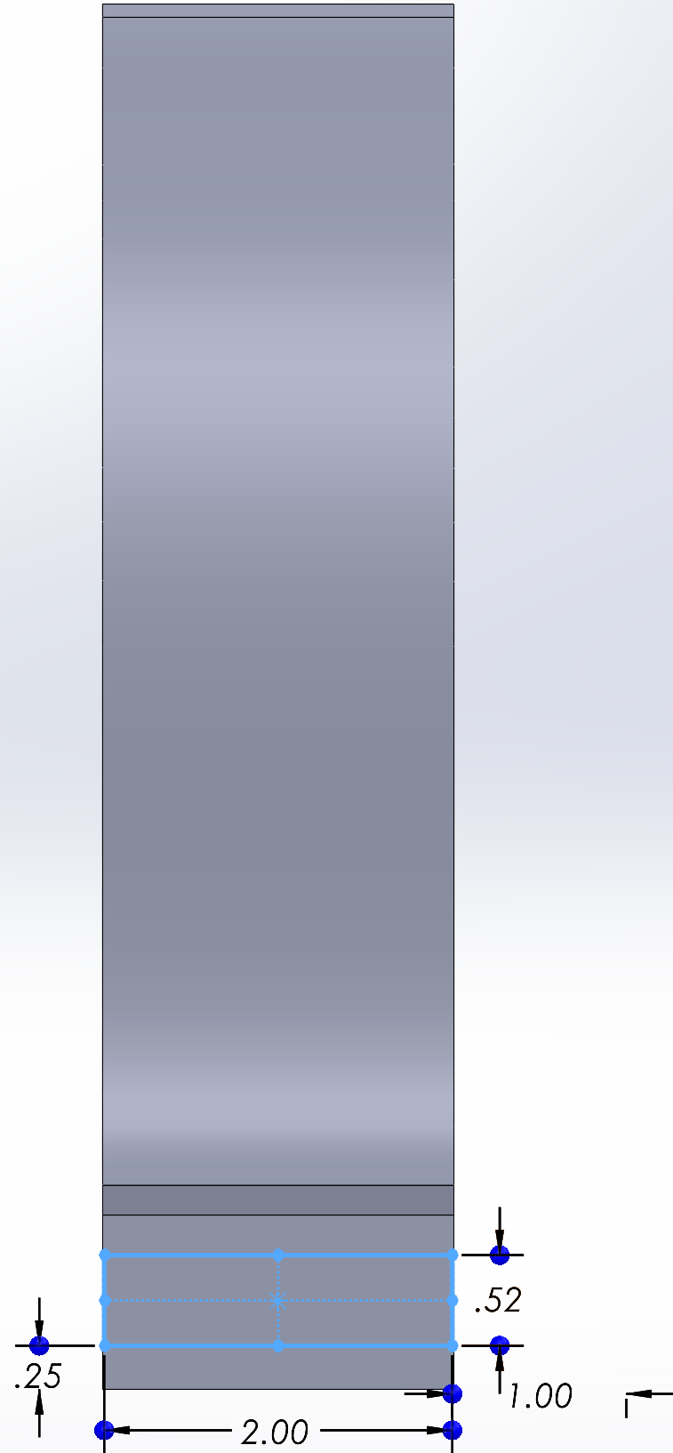
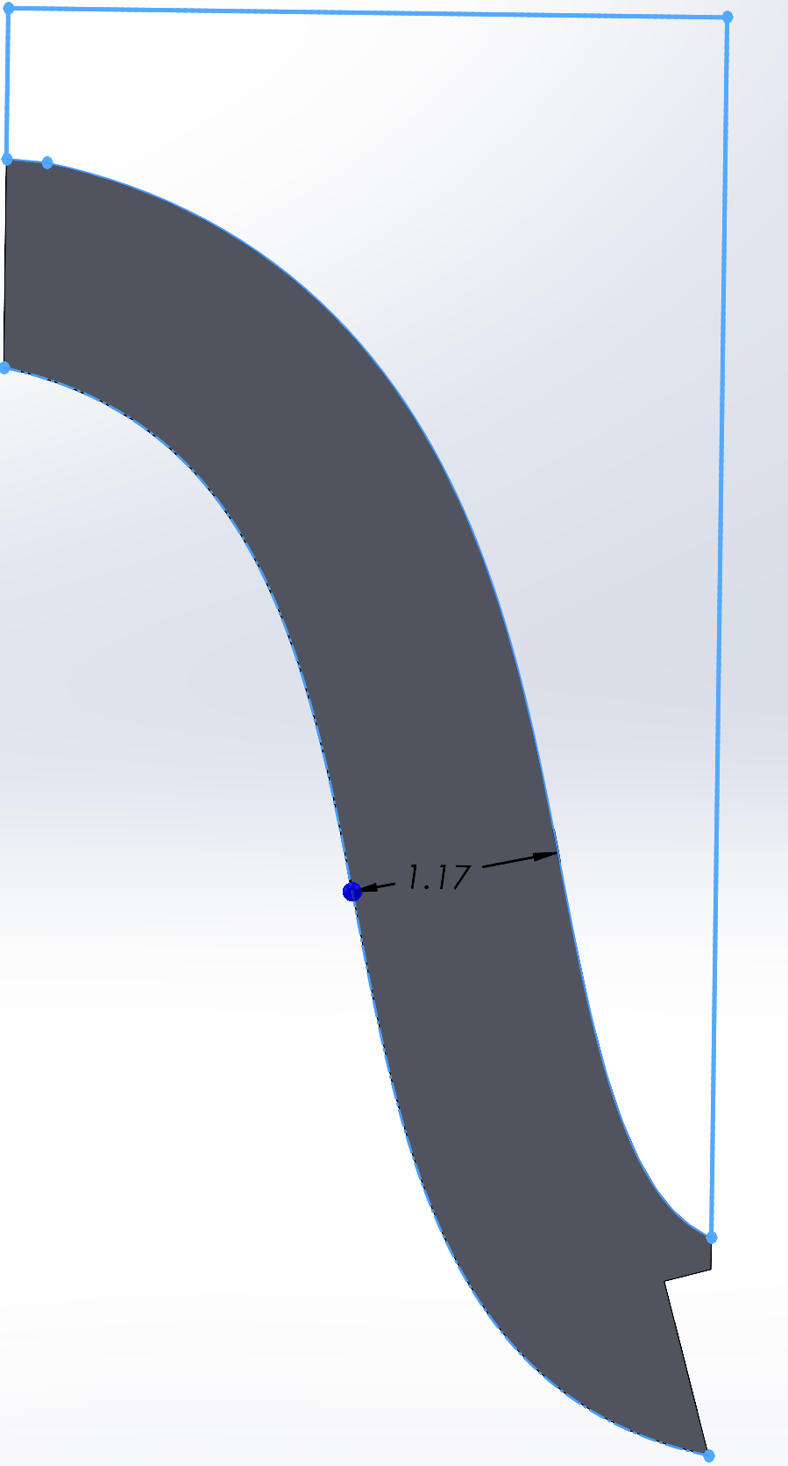

Attempt 9:
Changed Force and Fixed Area
Design Meets Specs

Slide 12





Attempt 10:
Implemented Holes
Decreased the Width
Force Area
Fixed Area
Design Meets Specs

